Slide 1

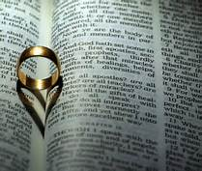
Todays Marriage
Genesis 2:24

Slide 2
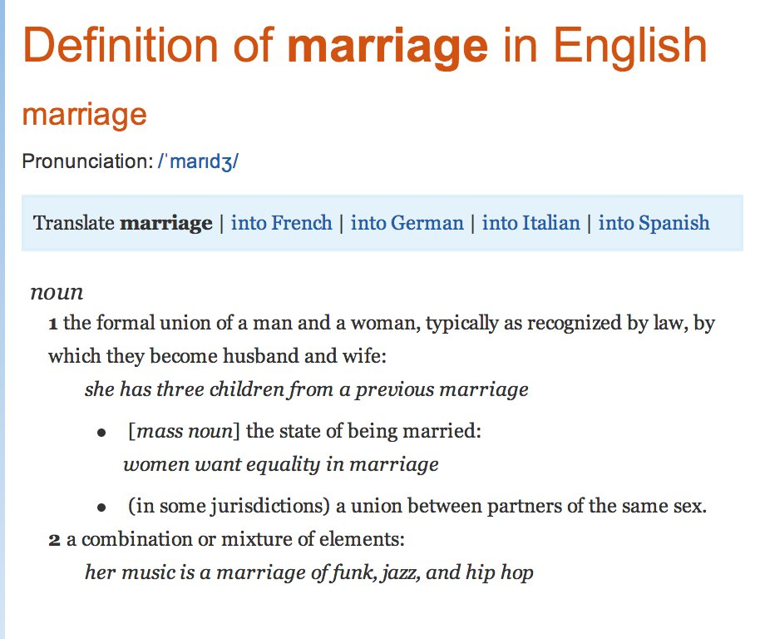
Todays Marriage

Slide 3



Todays Marriage

Slide 4

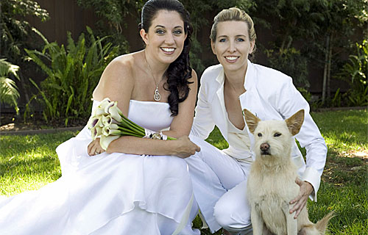

Todays Marriage
Genesis 1:27-28

Slide 5
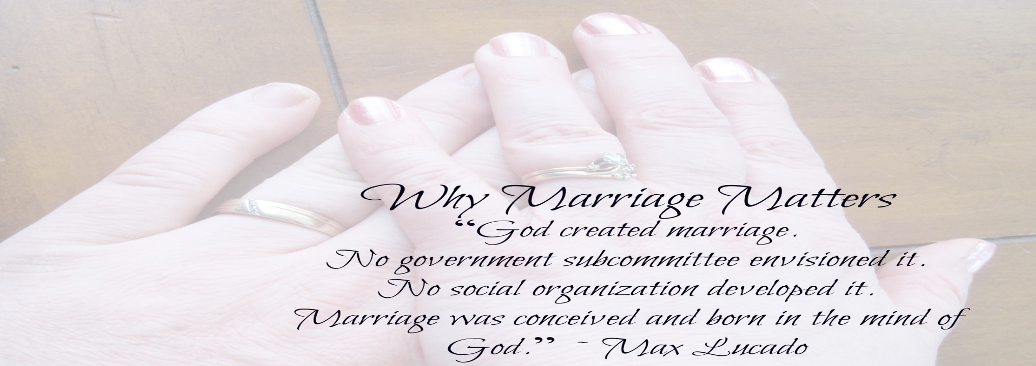


Todays Marriage

Slide 6
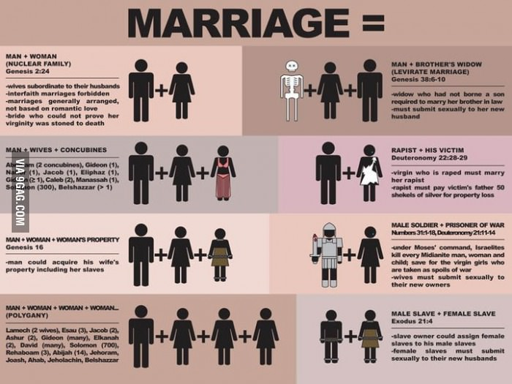
Todays Marriage
Acts 17:30

Slide 7
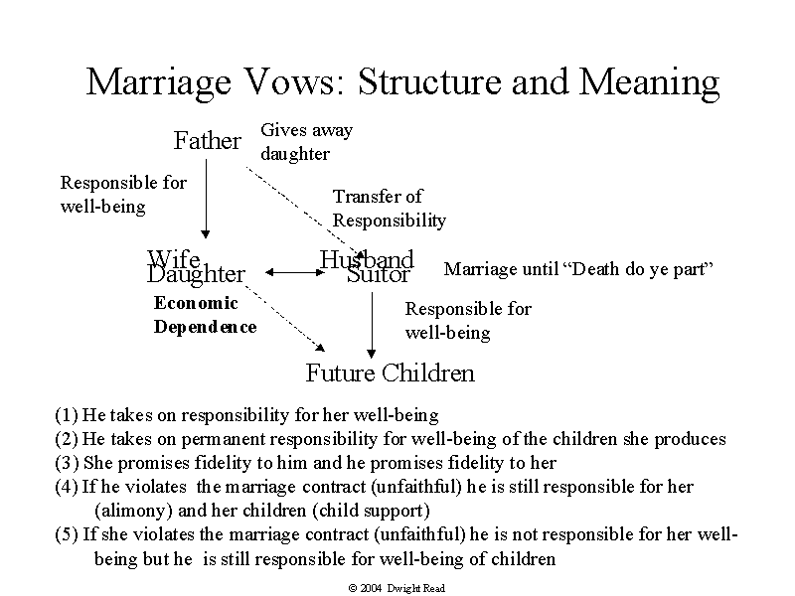
Todays Marriage

Slide 8

Todays Marriage
Many today marry without considering God. God's law is simple, and is clearly revealed in His word.
(The Bible)

Slide 9
GOD’S DESIGN
From the beginning it involved one man one woman for life
God institutes marriage Genesis 2:18-24
Christ reaffirms marriage Matt 19:3-7

Slide 10
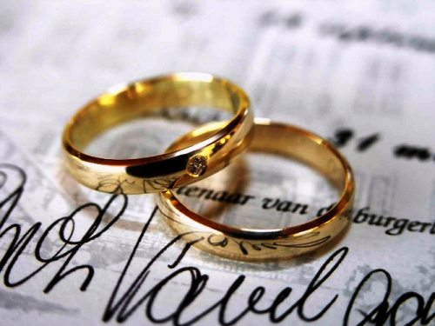
GOD
MAN
WOMAN

Slide 11
GOD’S DESIGN
Conclusion: Since marriage is of God (Gen 2:18-24) let’s learn to respect His laws governing this divine institution. And not change what he has laid out for us.
We need to teach our children and others that God’s design is the true design, not man’s.
There are two covenants we enter into with God in our lives one is marriage and the other is baptism

Slide 12
PLAN OF SALVATION
Hear: Rom 10:17
Believe Rom 10:9(James 2:19)
Repent Acts 17:30
Confess Rom 10:10
And be baptized Acts 22:16
Remain faithful Rev. 2:10

