Slide 1

Daniel’s Uncompromising Faith
Daniel in captivity. Dan. 1:1-7

Slide 2
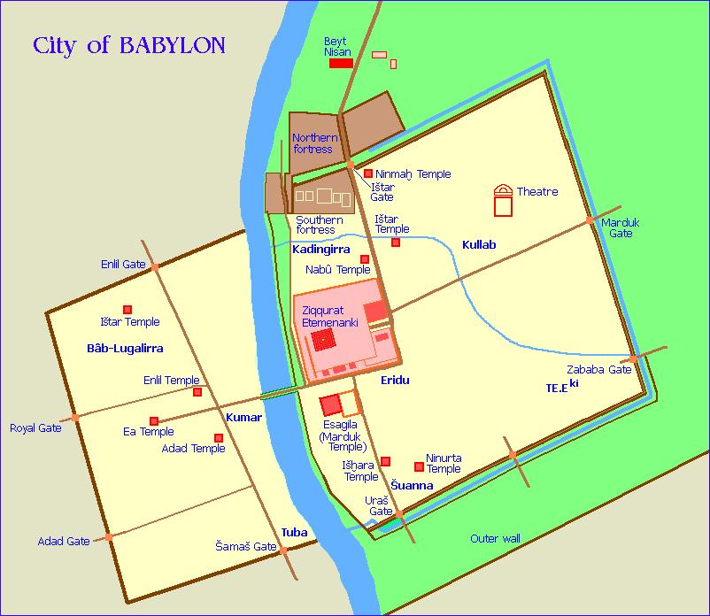

Slide 3
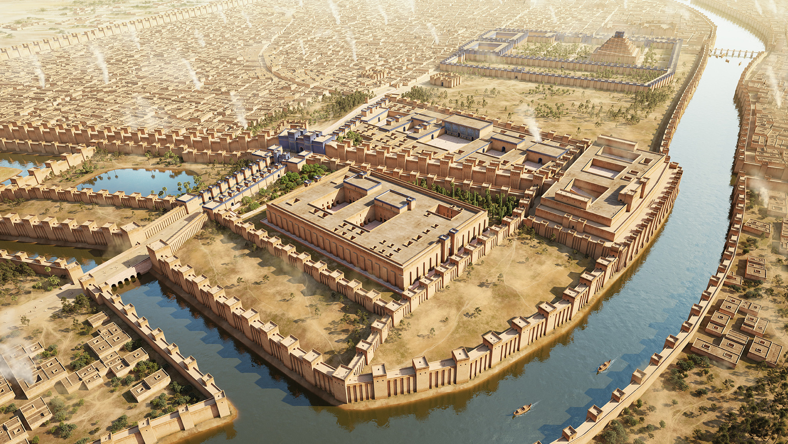

Slide 4
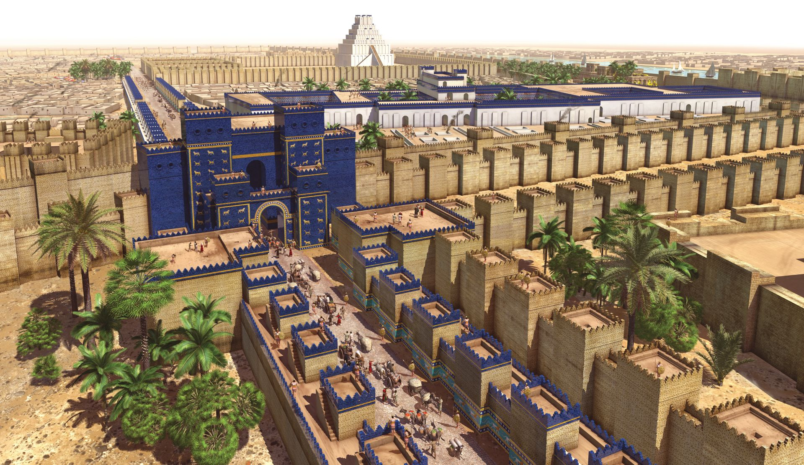

Slide 5


Slide 6
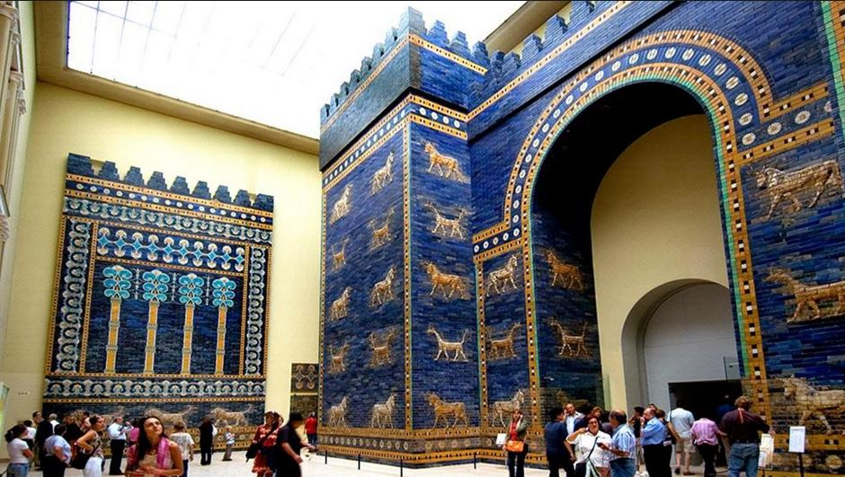

Slide 7


Slide 8
Daniel’s Uncompromising Faith
Daniel in captivity. Dan. 1:1-7
Daniel’s determination to follow God. Dan. 1:8
Materialism. Heb. 11:24-26
Power. Matt. 20:25-27
Fornication. 1 Cor. 6:18-20
Worldly wisdom. 1 Cor. 1:25-27
Daniel’s plan to remain pure. Dan. 1:9-16
Daniel’s faith is rewarded. Dan. 1:17-21; Jms. 1:12
You can have a faith like Daniel’s

