Slide 2
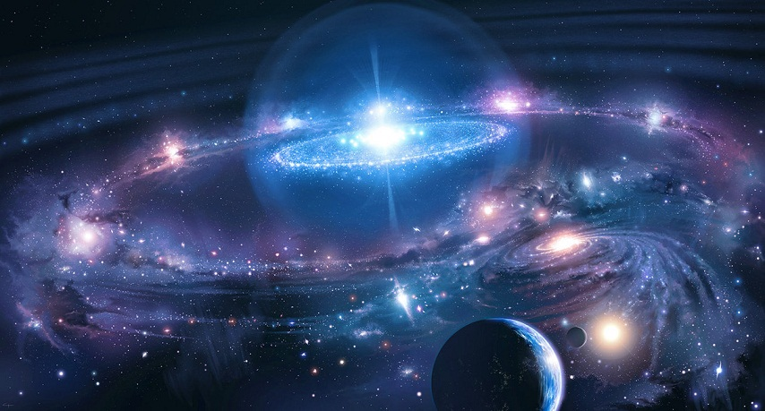


Revelation 14:7
“Fear God and give glory to Him . . .”

Slide 3
Genesis 1:
1 In the beginning God created the heavens and the earth.
2 The earth was without form, and void; and darkness was on the face of the deep. And the Spirit of God was hovering over the face of the waters.

Slide 4
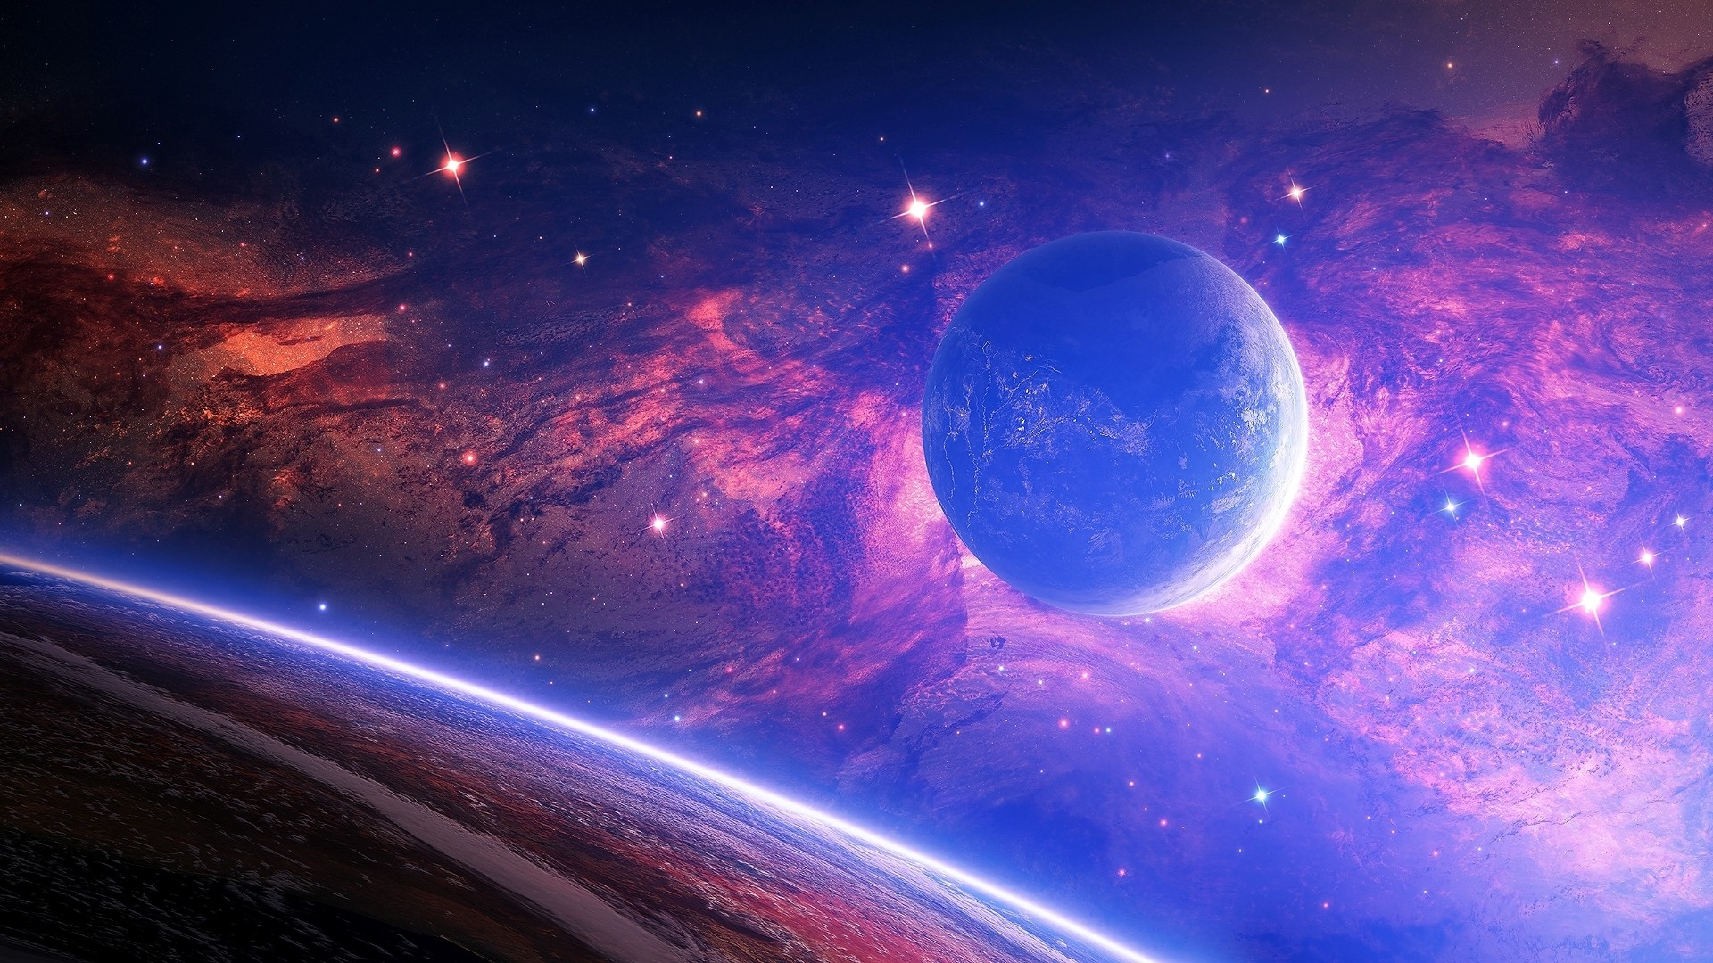

Slide 5
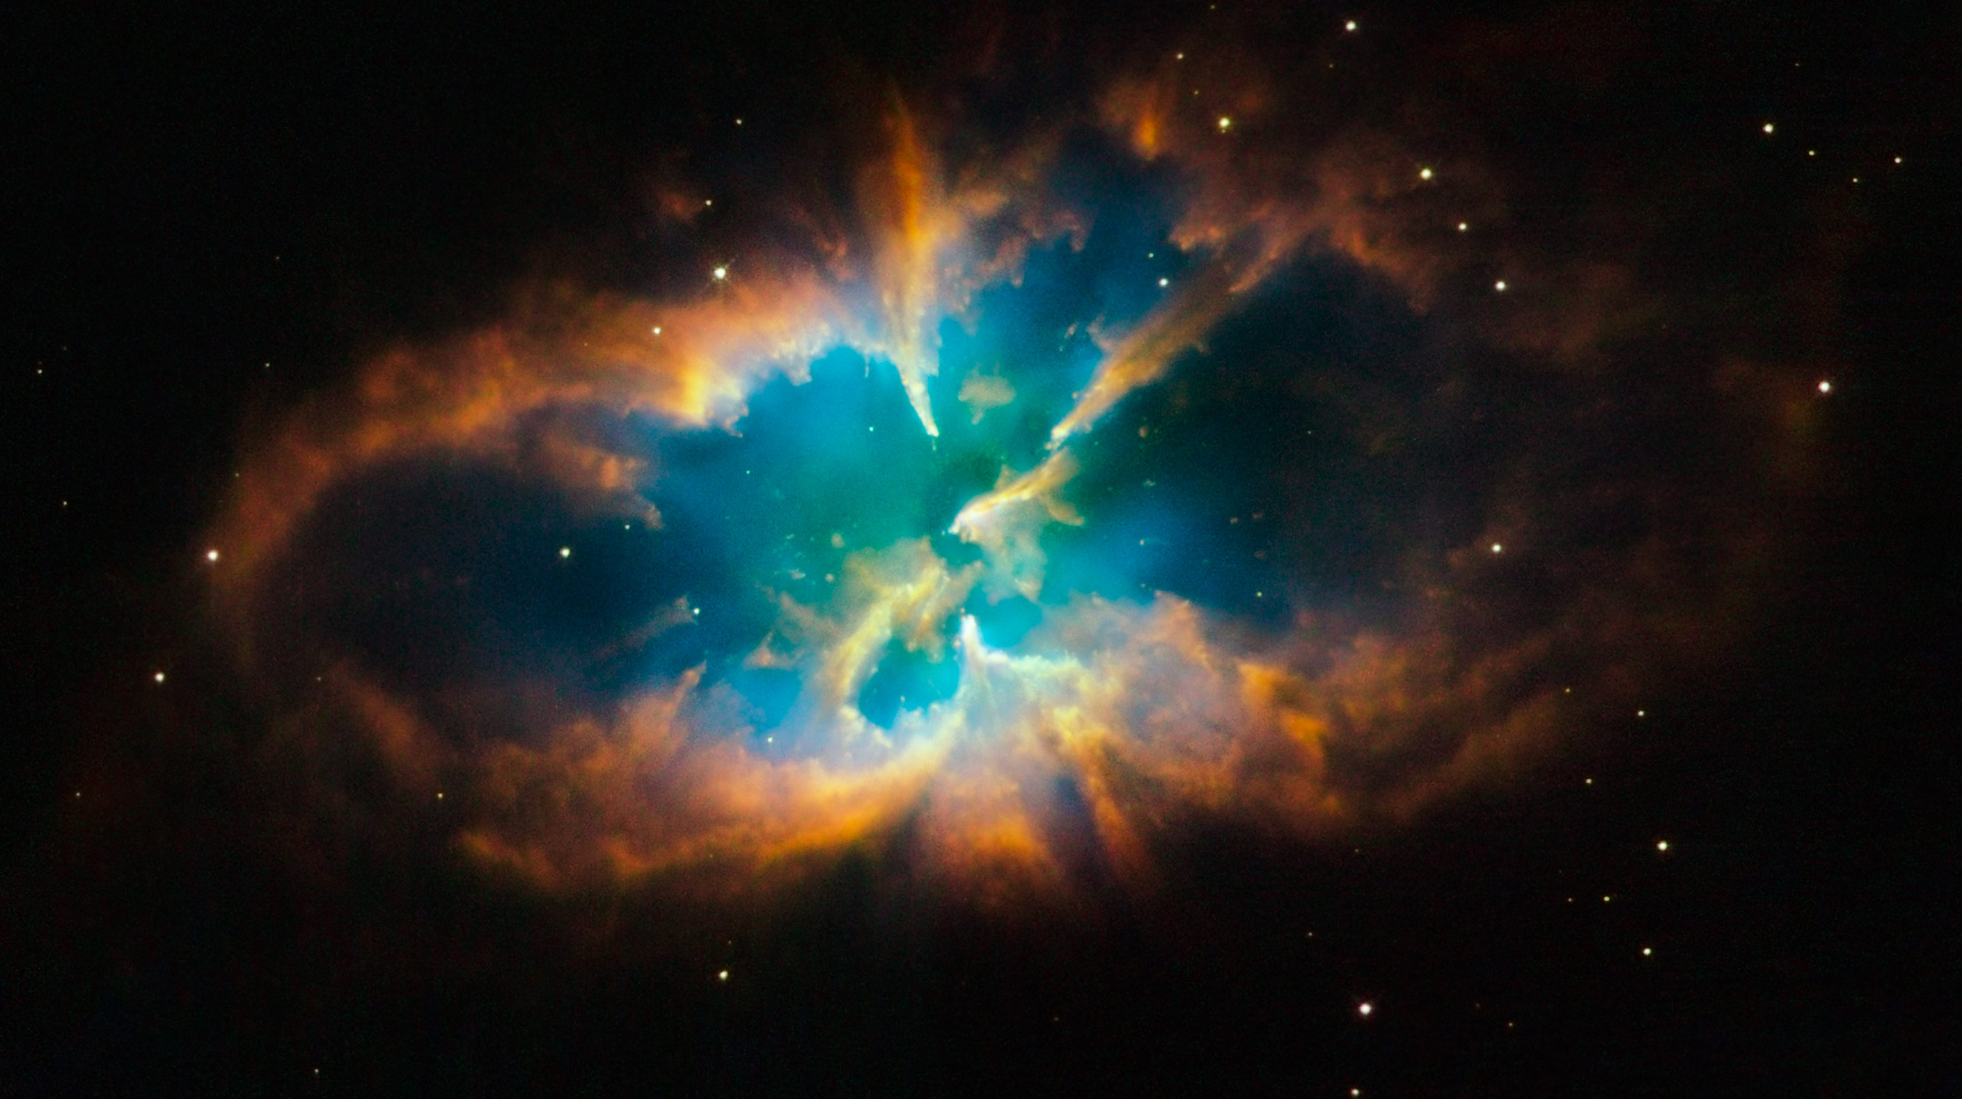

Slide 6
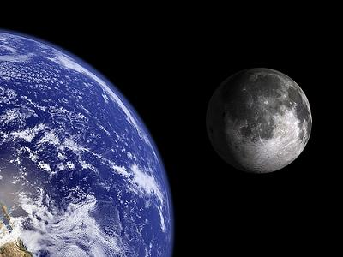

Slide 7
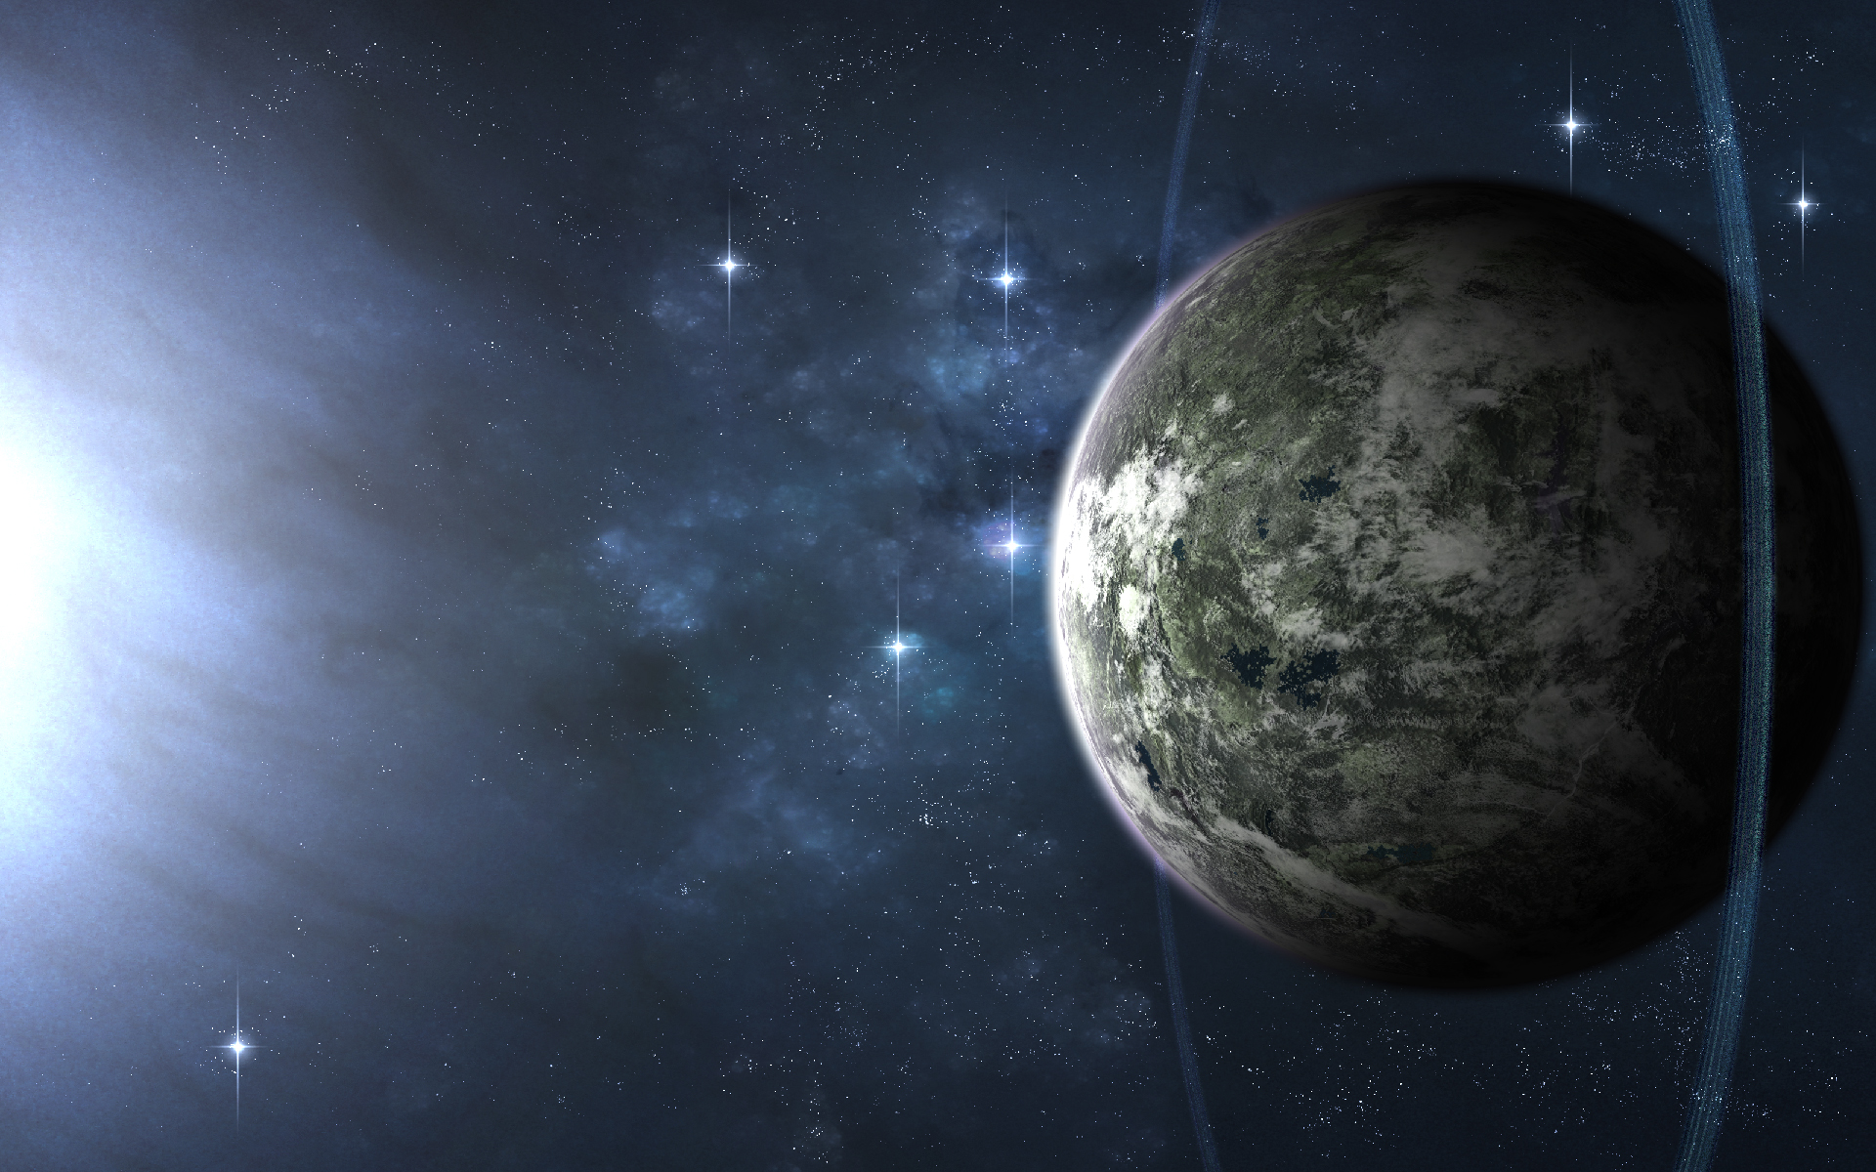

Slide 8
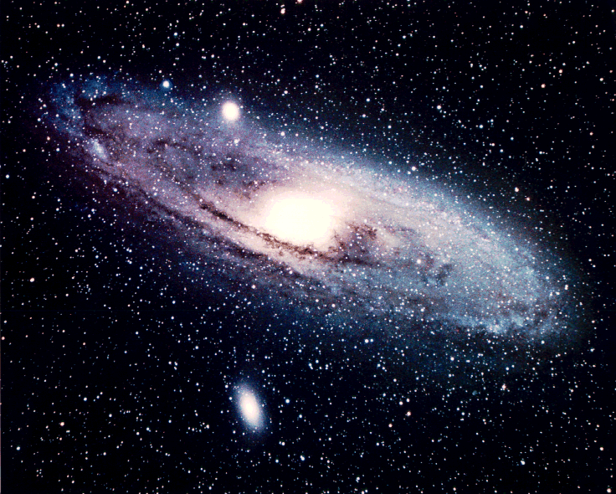

Slide 9
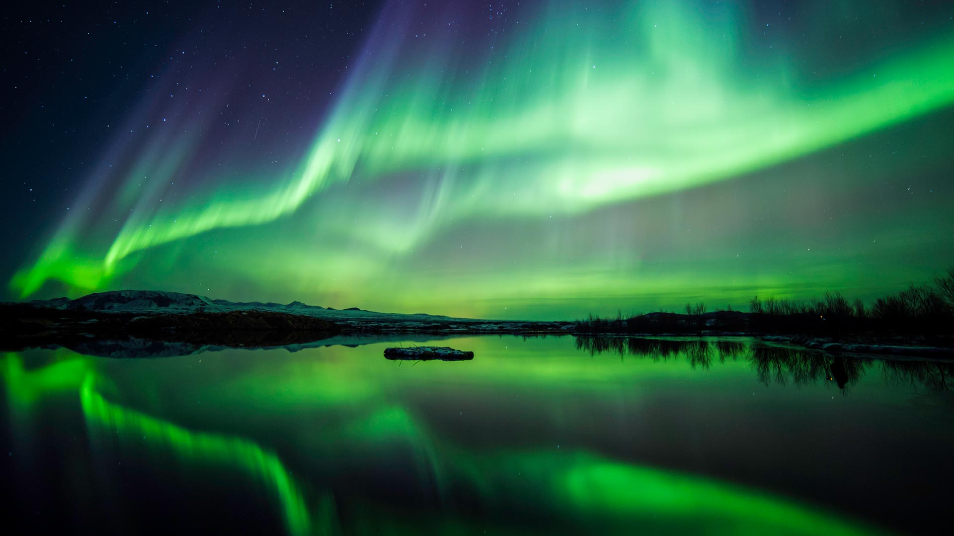

Slide 10
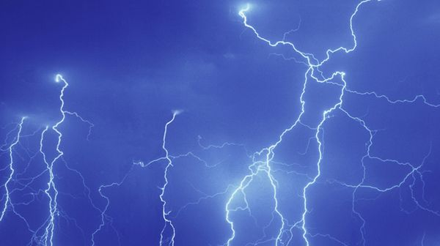

Slide 11
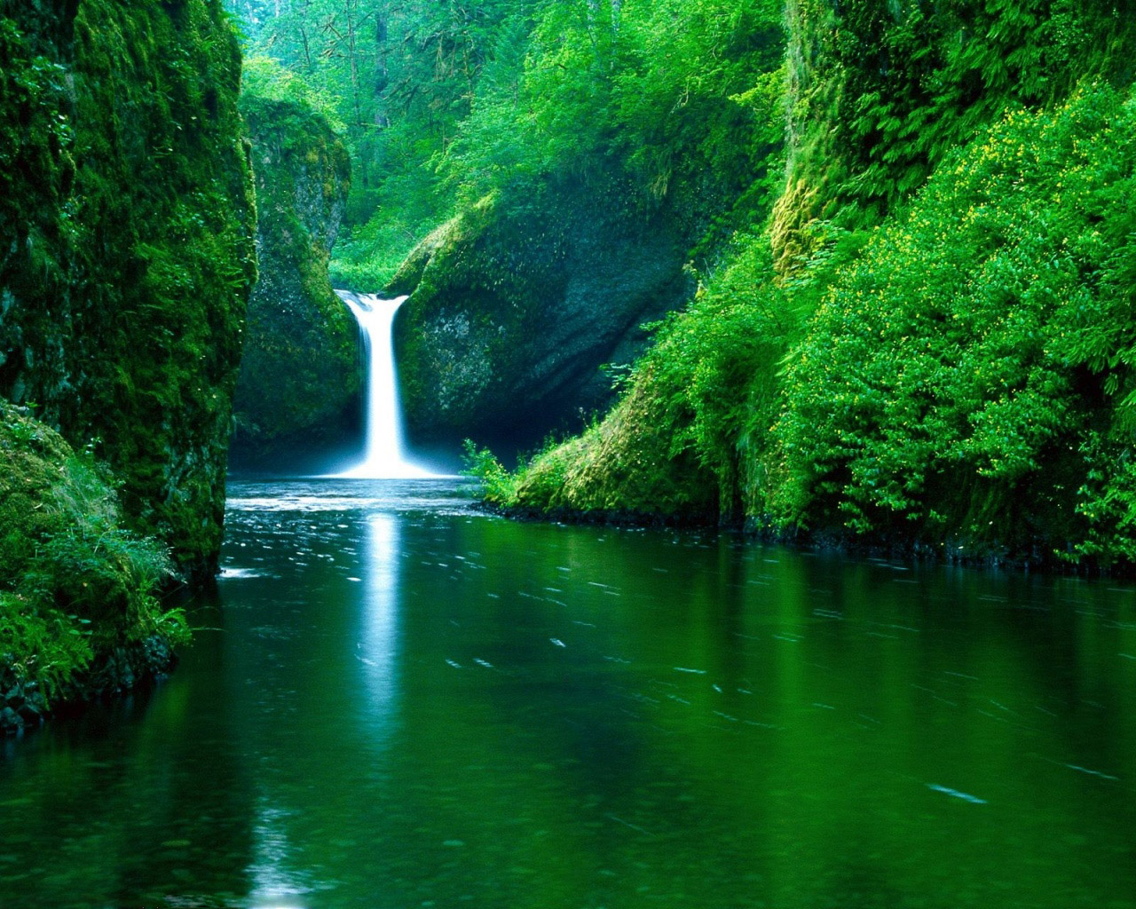

Slide 12
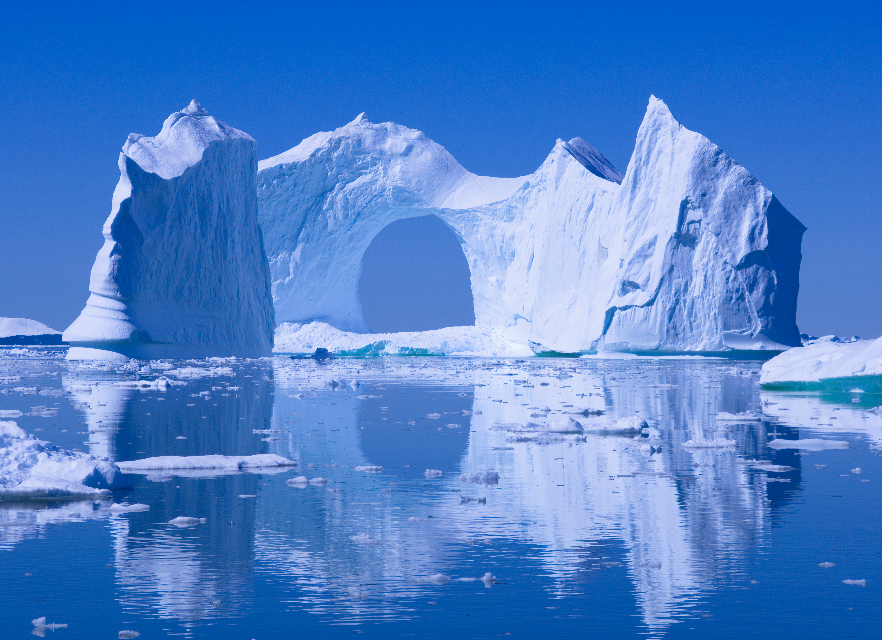

Slide 13
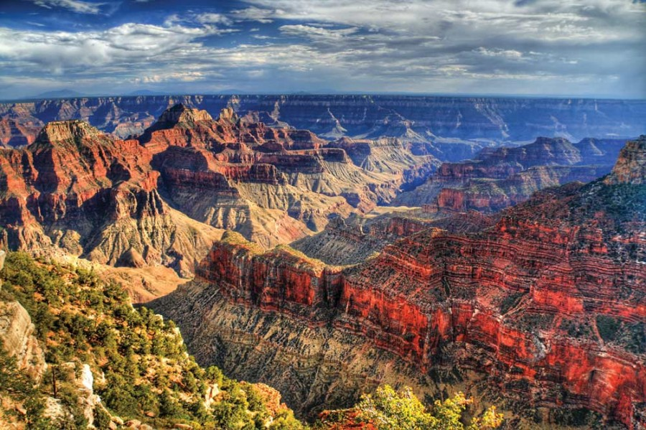

Slide 14
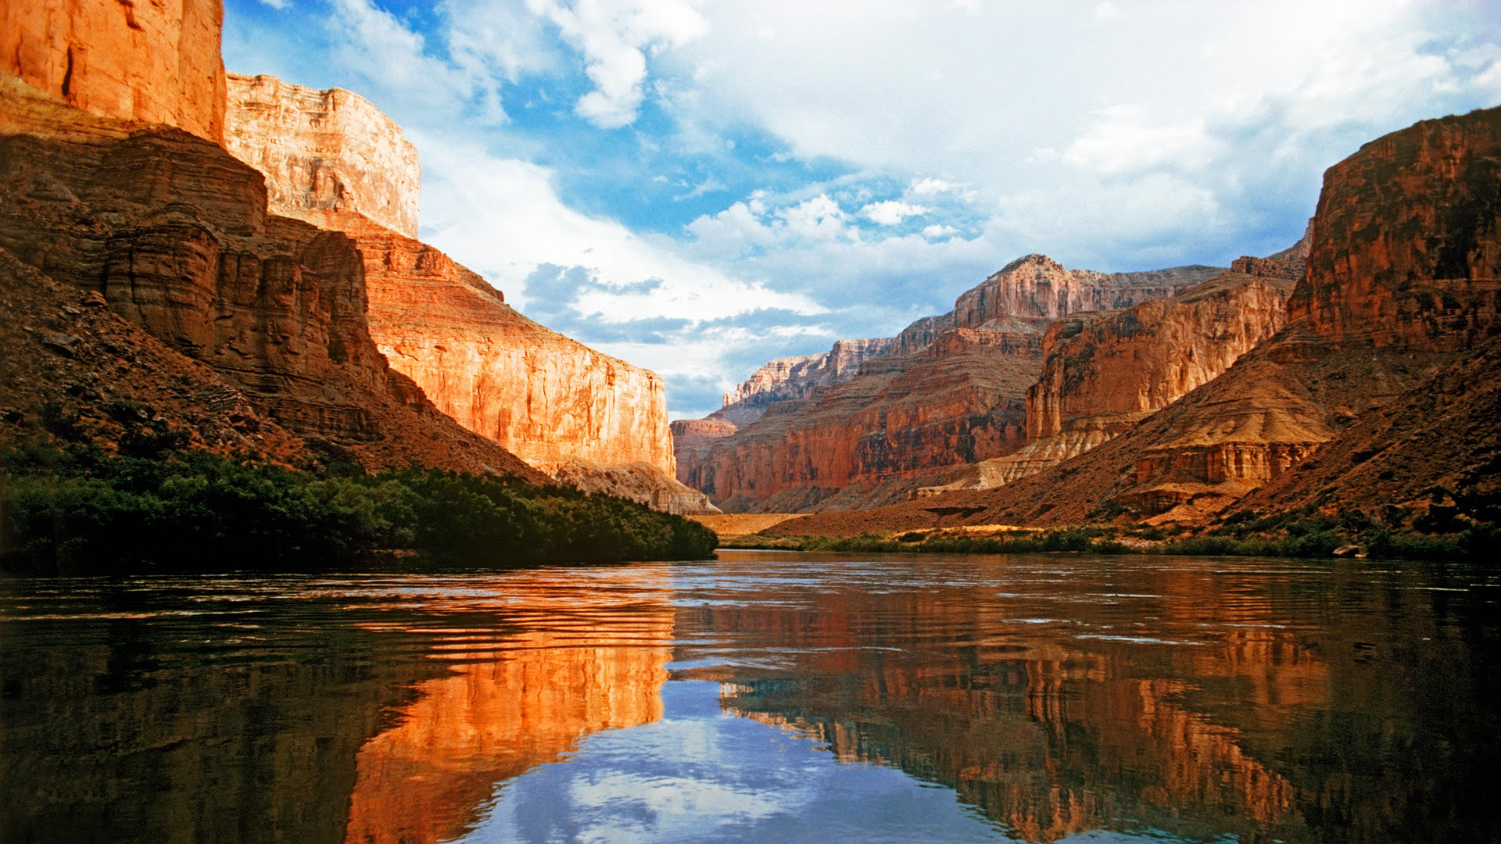


Slide 15
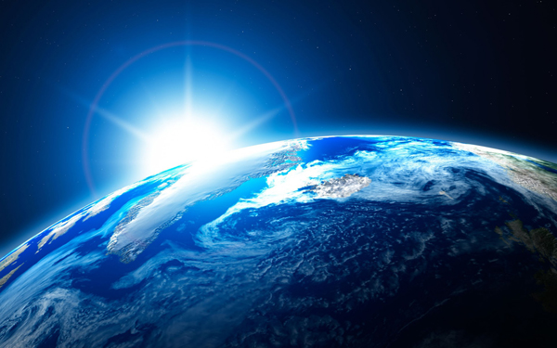
Revelation 14:7
“Fear God and give glory to Him . . .”
phobeo
THAYER:
“To fear, be afraid, to be struck with fear, to be seized with alarm, to reverence, venerate, to treat with deference or reverential obedience.”

Slide 16
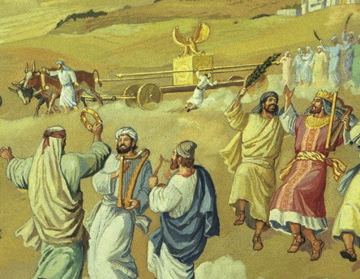
2 Sam 6:7
And the anger of the LORD burned against Uzzah, and God struck him down there for his irreverence; and he died there by the ark of God. (NASB)

Slide 17
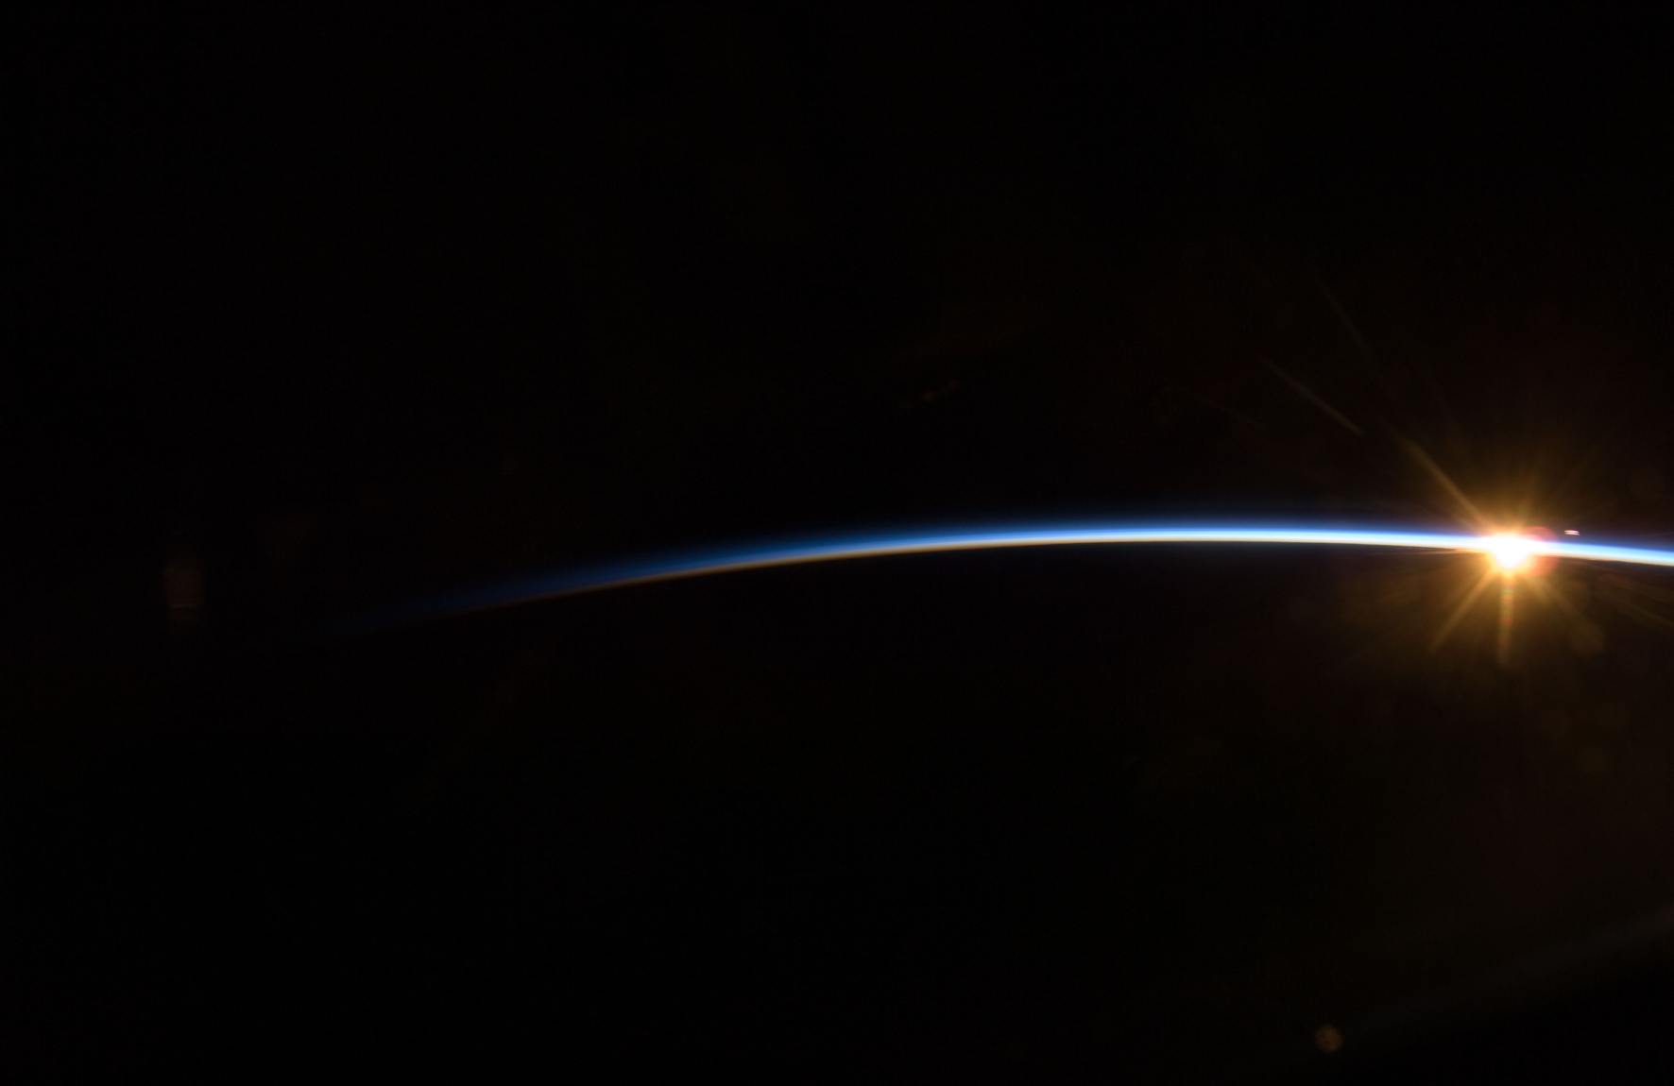
The Lord reigns; let the peoples tremble! He dwells between the cherubim; let the earth be moved! The Lord is great in Zion, and He is high above all the peoples. Let them praise Your great and awesome name—He is holy. (Psa 99:1-3)
He has sent redemption to His people;
He has commanded His covenant forever: Holy and awesome is His name. (Psa 111:9)
God is greatly to be feared in the assembly of the saints, and to be held in reverence by all those around Him. (Psa 89:7)
In the year that King Uzziah died, I saw the Lord sitting on a throne, high and lifted up, and the train of His robe filled the temple. Above it stood seraphim; each one had six wings: with two he covered his face, with two he covered his feet, and with two he flew. And one cried to another and said: Holy, holy, holy is the Lord of hosts; the whole earth is full of His glory! . (Isa 6:1-3)
Revelation 14:7
“Fear God and give glory to Him . . .”
Therefore, since we are receiving a kingdom which cannot be shaken, let us have grace, by which we may serve God acceptably with reverence and godly fear. (Heb 12:28)

Slide 18
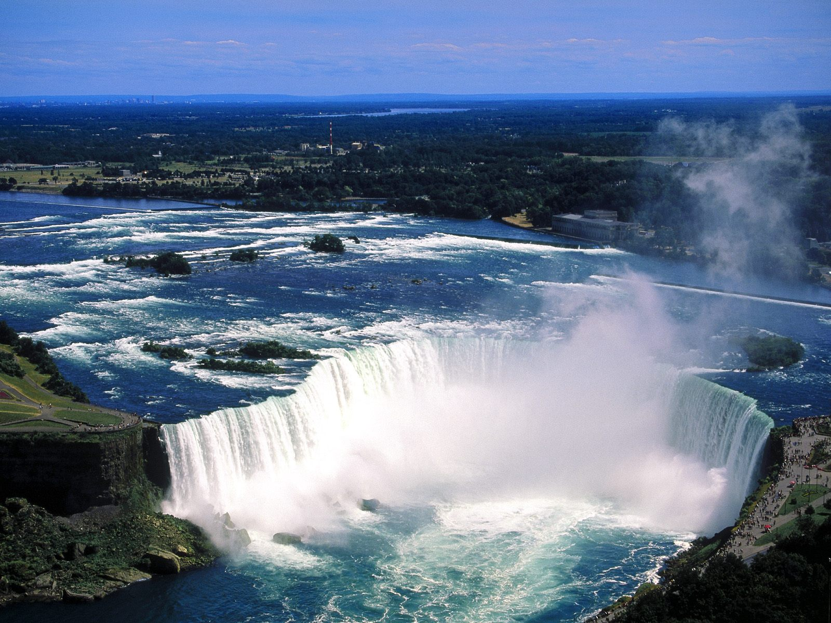

To God’s Majestic Essence
To God’s Incredible Power
To God’s Amazing Mercy

