Slide 2
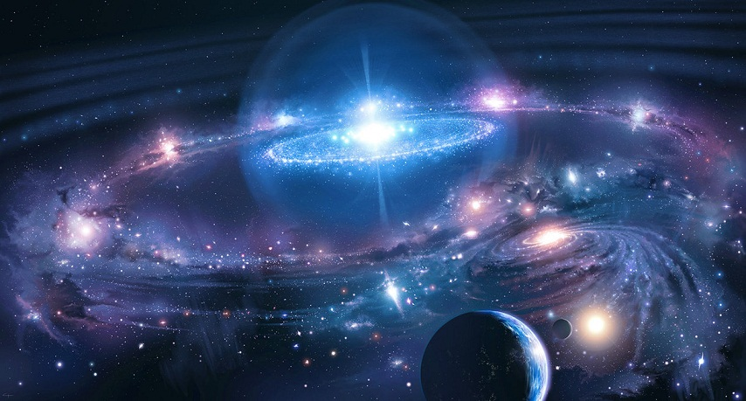


Revelation 14:7
“Fear God and give glory to Him . . .”

Slide 3
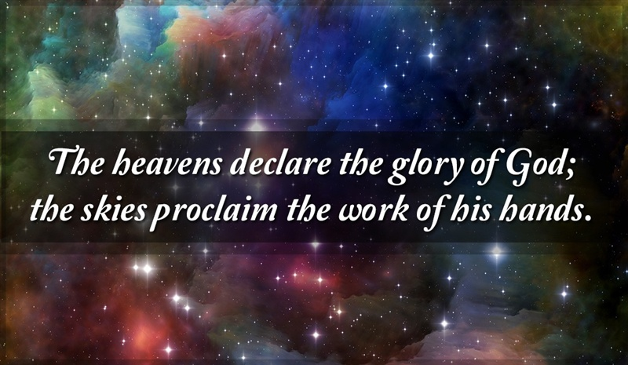
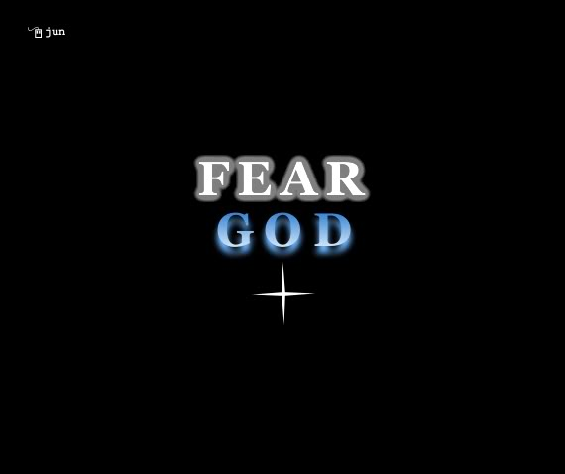
Reverence is a Response
His Holy Nature
His Awesome Power
His Loving Mercy

Slide 4
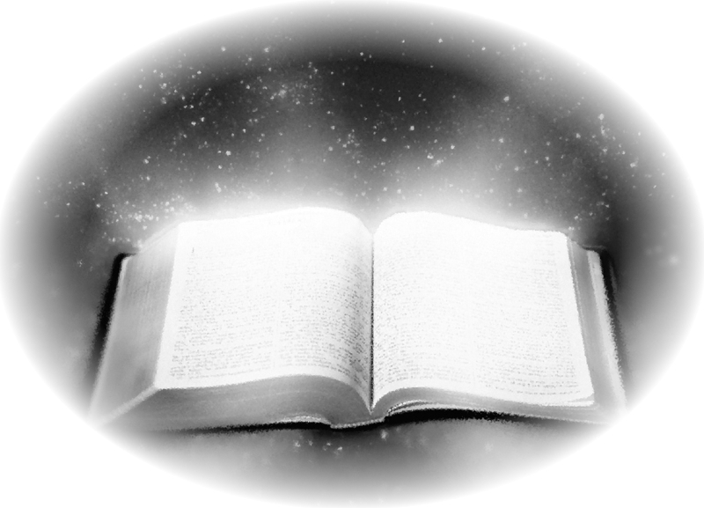
“yare”
Tremble, dread, Reverence
Exod 14:31 (Feared)
Prov 3:7 (Fear)
Psa 89:7
God is greatly to be feared in the assembly of the saints, and to be held in reverence by all those around Him.

Slide 5
“shachah”
To fall prostrate / worship
Gen 22:5 (Worship)
1 Sam 1:3 (Worship)
Esther 3:5
And when Haman saw that Mordecai bowed not, nor did him reverence, then was Haman full of wrath.

Slide 6
“aidōs”
A sense of shame or
honor, modesty,
bashfulness, regard for
others, respect
1 Tim 2:9 (Shamefacedness)
Heb 12:28
Therefore, since we are receiving a kingdom which cannot be shaken, let us have grace, by which we may serve God acceptably with reverence and godly fear.

Slide 7
“phobeō”
To fear, be afraid, to
reverence, venerate, to treat
with deference or
reverential obedience
Acts 10:22 (Fears)
Acts 13:26 (Fear)
Eph 5:33
Nevertheless let every one of you in particular so love his wife even as himself; and the wife see that she reverence her husband.

Slide 8
“entrepō”
To respect
Lk 20:13 (Respect)
Heb 12:9
Furthermore we have had fathers of our flesh which corrected us, and we gave them reverence . . .

Slide 9
“eusebeiā”
Reverence, respect,
piety towards God,
godliness
2 Pet 3:11 (godliness)
1 Tim 4:7
But reject profane and old wives' fables, and exercise yourself toward godliness.

Slide 10

2 Timothy 3:5
Having a form of godliness but denying its power. And from such people turn away! (NKJ)
Holding to a form of godliness, although they have denied its power; and avoid such men as these. (NAS)
Holding the form of religion but denying the power of it. Avoid such people. (RSV)
They will maintain the outward appearance of religion but will have repudiated its power. So avoid people like these. (NEB)

Slide 11
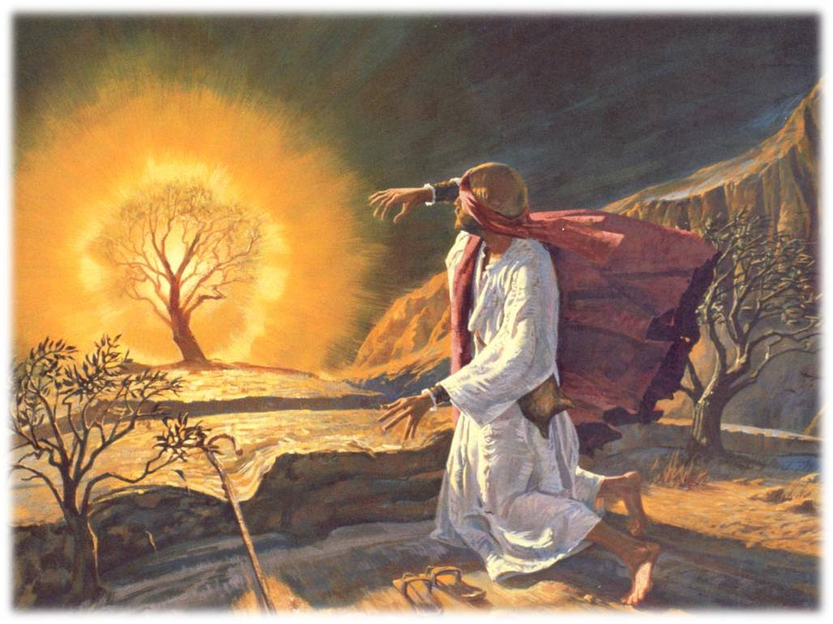
Living Daily on Holy Ground
Exod 3:4-6
. . . God called to him from the midst of the bush and said, Moses, Moses! And he said, here I am. Then He said, do not draw near this place. Take your sandals off your feet, for the place where you stand is holy ground. Moreover He said, I am the God of your father-- the God of Abraham, the God of Isaac, and the God of Jacob . . .

Slide 12
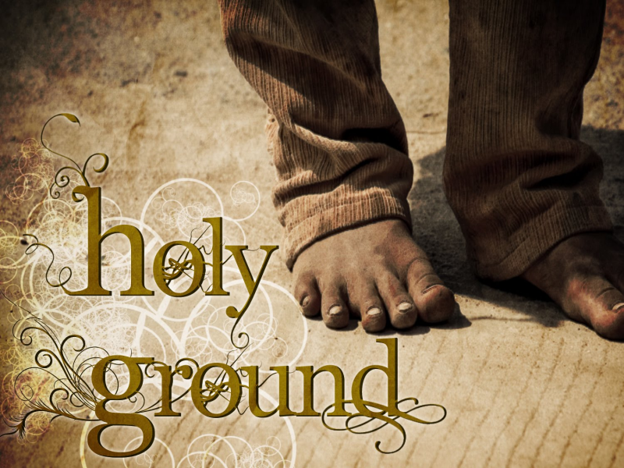
Living Daily on Holy Ground
Never Surrenders to Doubt ~ Eph 3:20
Knows God Wants our Best ~ Rom 8:28
Comforts us at Death ~ Acts 7:59
Lays up Treasure in Heaven ~ Matt 6:20

Slide 13
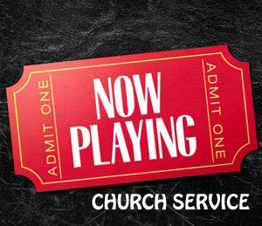
Manufactured Reverence

Slide 14
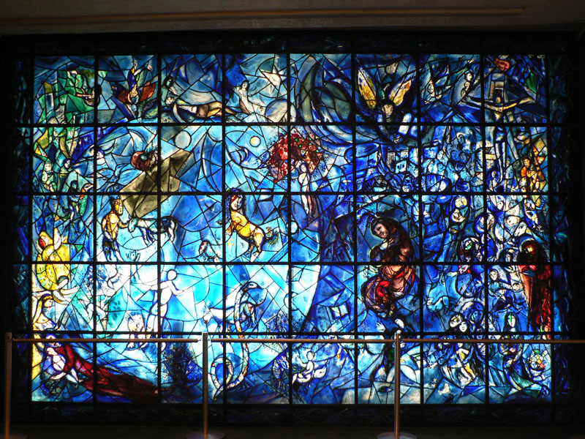
Manufactured Reverence

Slide 15
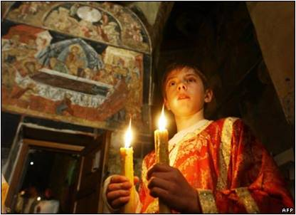
Manufactured Reverence

Slide 16
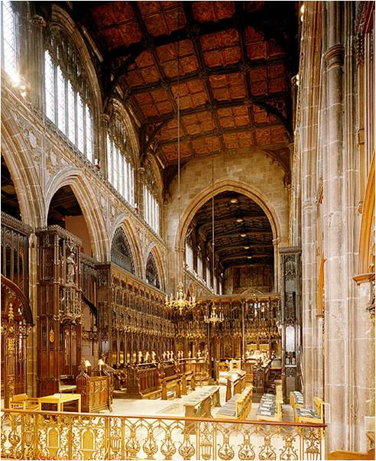
Manufactured Reverence

Slide 17
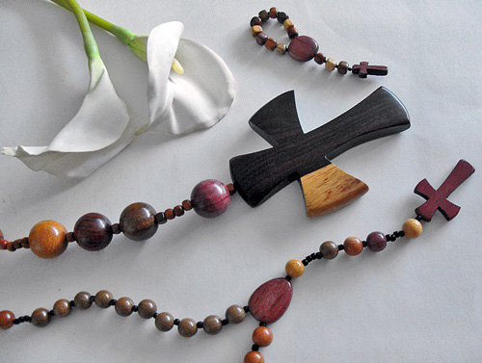
Manufactured Reverence

Slide 18
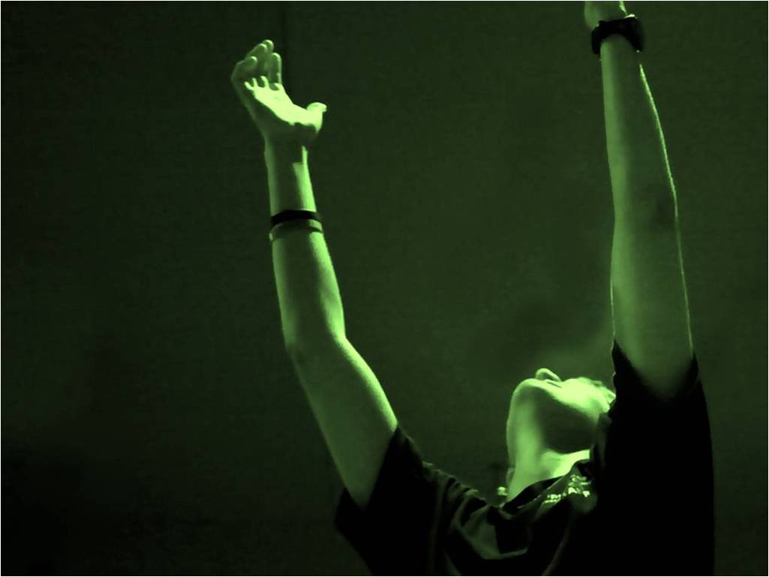
Manufactured Reverence

Slide 19
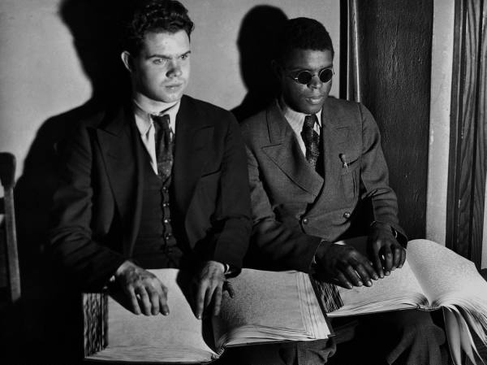
What are these to a blind man?

Slide 20
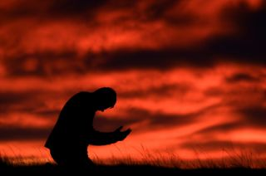
Reverence: You Cannot Fake It
1 Tim 4:7-8
But reject profane and old wives' fables, and exercise yourself toward godliness.
For bodily exercise profits a little, but godliness is profitable for all things, having promise of the life that now is and of that which is to come.
“gumnazō̄”
To exercise vigorously, in any way, body or mind
“eusebeiā”
Reverence, respect,
piety towards God

Slide 21
Exercising Towards Reverence
“See” the LORD on His Throne
Must begin a Training Regimen
Recognize the Need to Sacrifice

