Slide 2
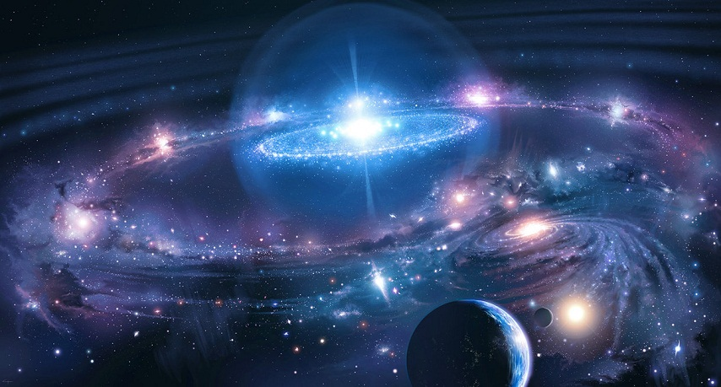


Revelation 14:7
“Fear God and give glory to Him . . .”

Slide 3
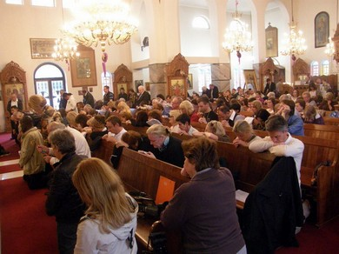
Revelation 14:7
“Fear God and give glory to Him . . .”
Psalm 95:6
Oh come, let us worship and bow down; let us kneel before the LORD our Maker.
Hebrews 12:28-29
Therefore, since we are receiving a kingdom which cannot be shaken, let us have grace, by which we may serve God acceptably with reverence and godly fear. For our God is a consuming fire.

Slide 4
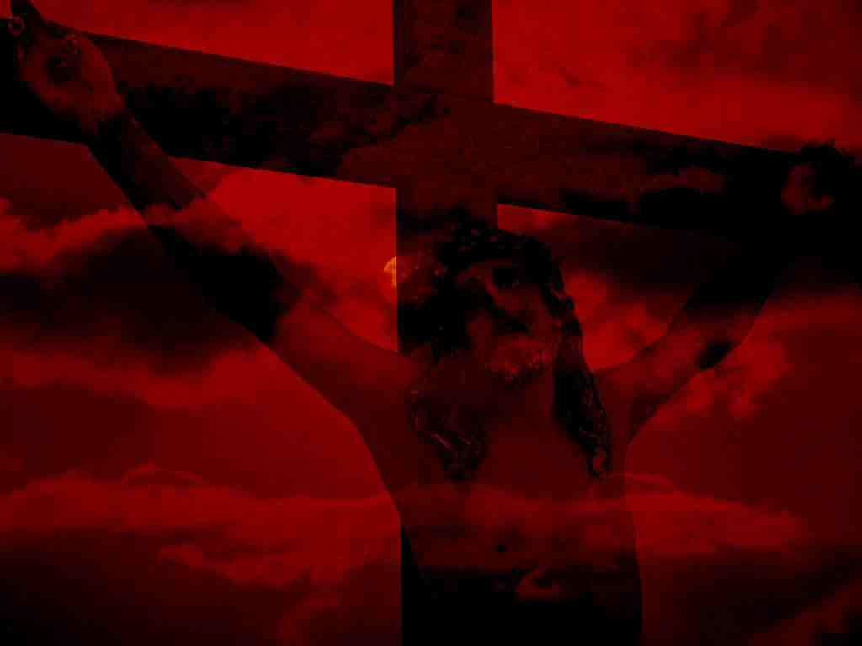
Revelation 14:7
“Fear God and give glory to Him . . .”
Luke 23:
39 Then one of the criminals who were hanged blasphemed Him, saying, if You are the Christ, save Yourself and us.
40 But the other, answering, rebuked him, saying, do you not even fear God, seeing you are under the same condemnation?

Slide 5
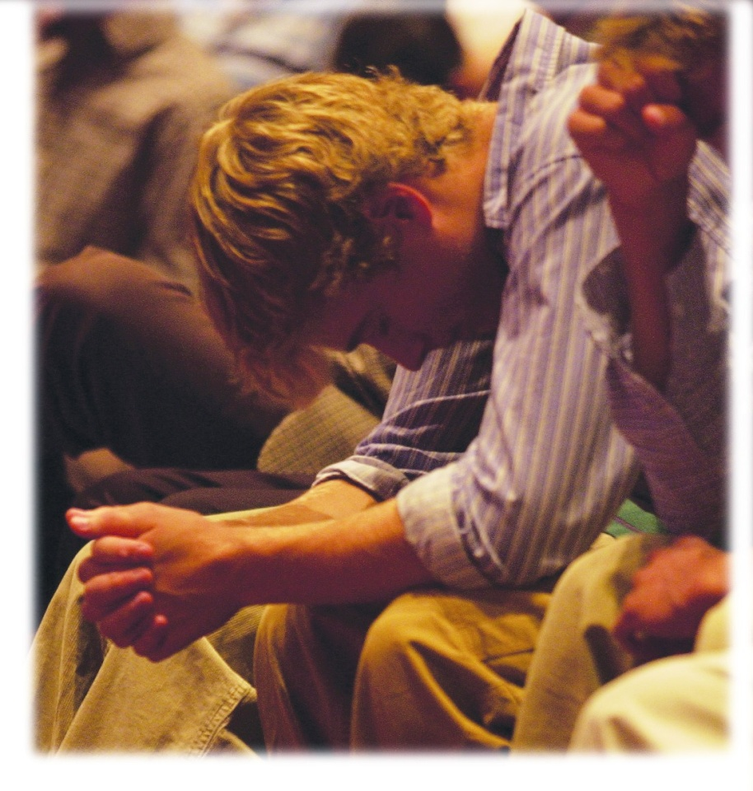
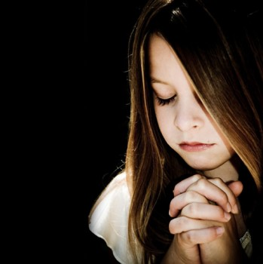
Matthew 28:9
Jesus met them, saying, Rejoice! So they came and held Him by the feet and worshiped Him.
Matthew 2:11
And when they had come into the house, they saw the young Child with Mary His mother, and fell down and worshiped Him.
Revelation 5:14
Then the four living creatures said, Amen! And the twenty-four elders fell down and worshiped Him who lives forever and ever.

Slide 6

1 Peter 1:8
Though now you do not see Him, yet believing, you rejoice with joy inexpressible and full of glory
Psalms 2:11
Serve the LORD with fear, and rejoice with
trembling.
Psalms 9:2
I will be glad and rejoice in you; I will sing praise to your name, O most High
Psalms 9:14
That I may tell of all Your praise in the gates of the daughter of Zion. I will rejoice in Your salvation
Reverence is
Not Sadness
1 Peter 4:13
You may also be glad with exceeding joy

Slide 7
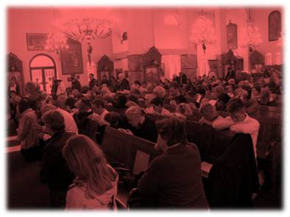
Lord’s Supper
Prayer
Singing
Teaching
Giving
Reverence is
Respectful
1 Corinthians 14:40
Let all things be done decently and in order.

Slide 8
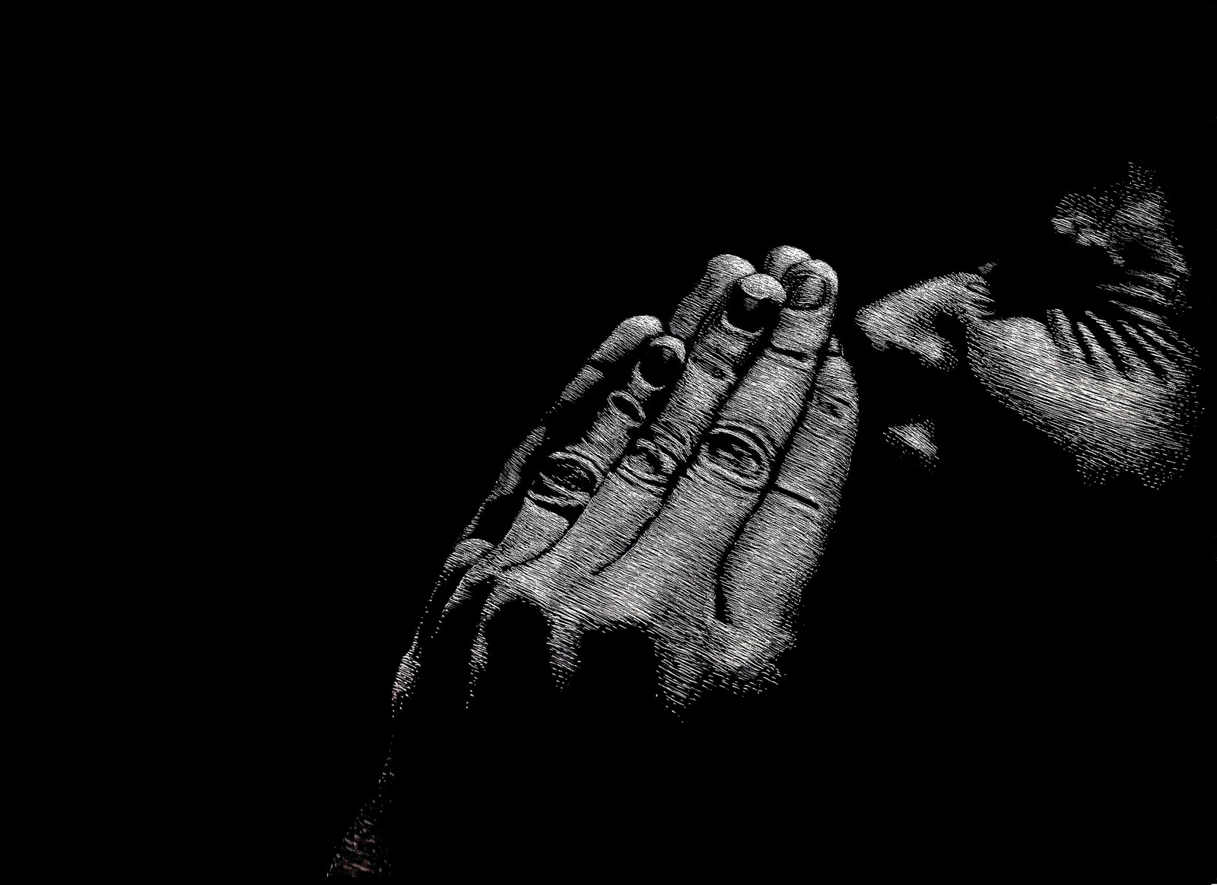





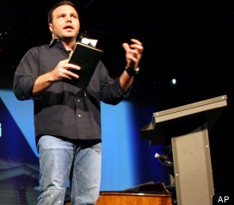

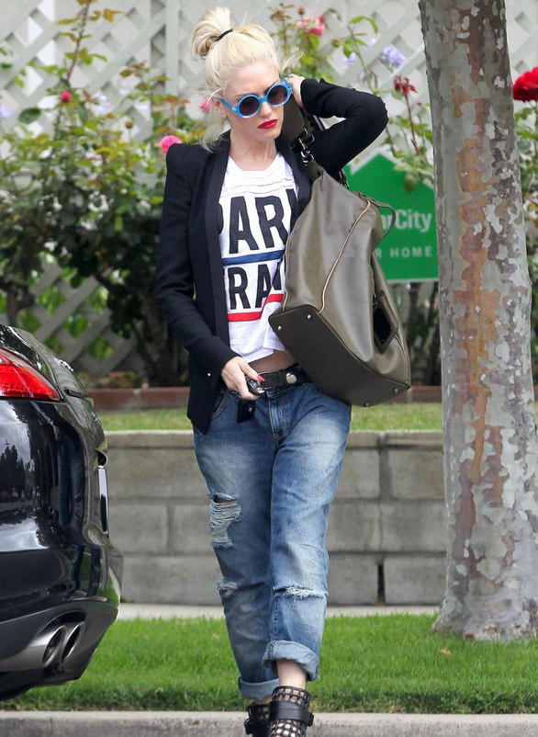
Reverence is
Never Casual

Slide 9
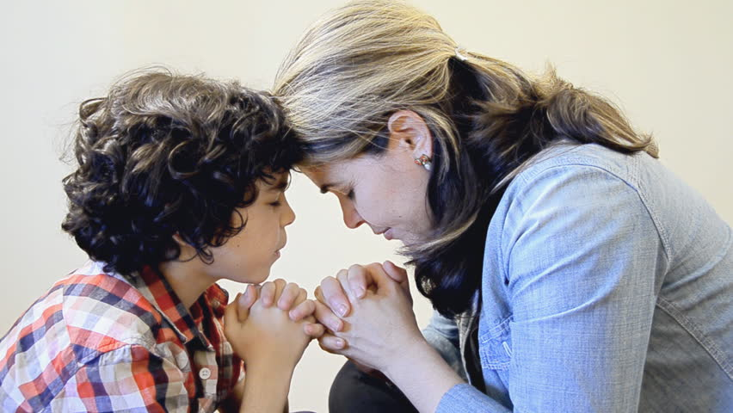
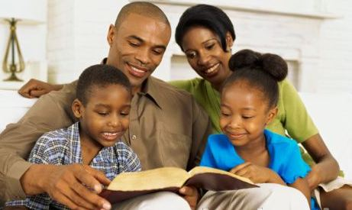
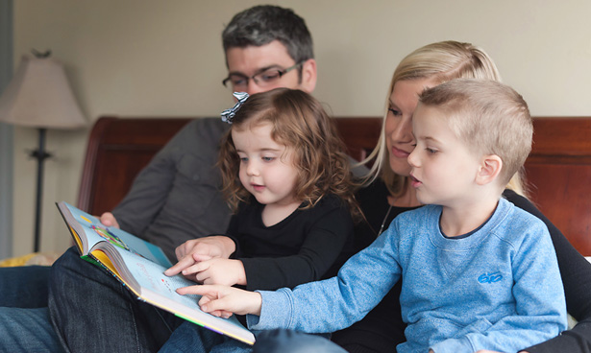
Reverence Will Be Taught To My Children

