Slide 2
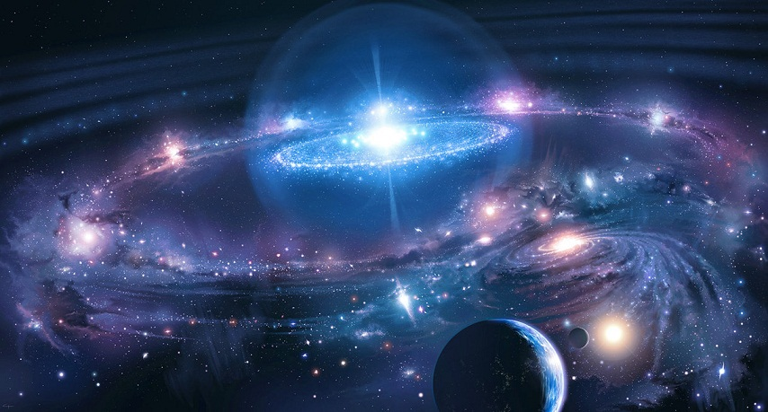


Revelation 14:7
“Fear God and give glory to Him . . .”

Slide 3
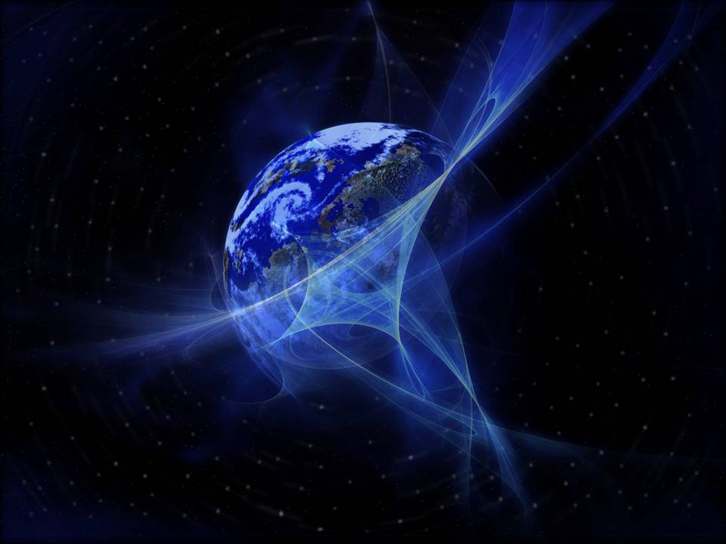
Psalms 33:8-9
Let all the earth fear the LORD; Let all the inhabitants of the world stand in awe of Him. For He spoke, and it was done; He commanded, and it stood fast.
You are beautiful beyond description Too marvelous for words, Too wonderful for comprehension, Like nothing ever seen or heard. Who can grasp your infinite wisdom? Who can fathom the depth of your love? You are beautiful beyond description, Majesty enthroned above.
And I stand, I stand, in awe of you. I stand, I stand in awe of you. Holy God, to whom all praise is due, I stand In awe of you!

Slide 4
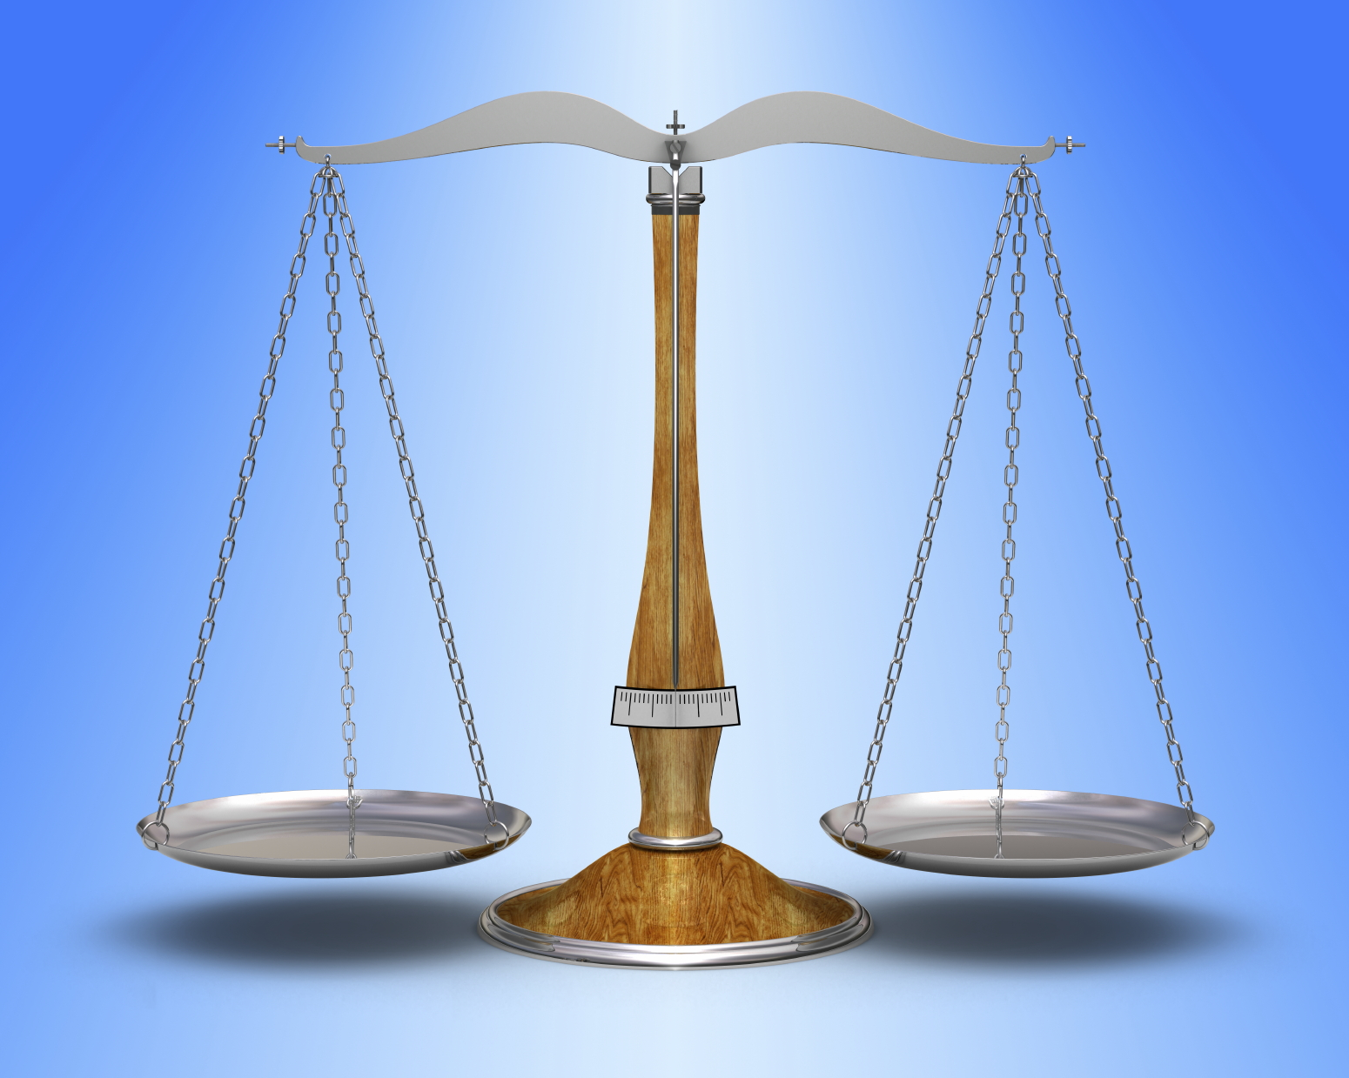
Awesome ~ Psa 99:3
Abba ~ Rom 8:15
Trembling ~ Psa 2:11
Rejoice ~ Psa 2:11
God ~ Jn 1:1-3
Friend ~ Jn 15:14
Reverence
Relationship
Maintaining Balance

Slide 5
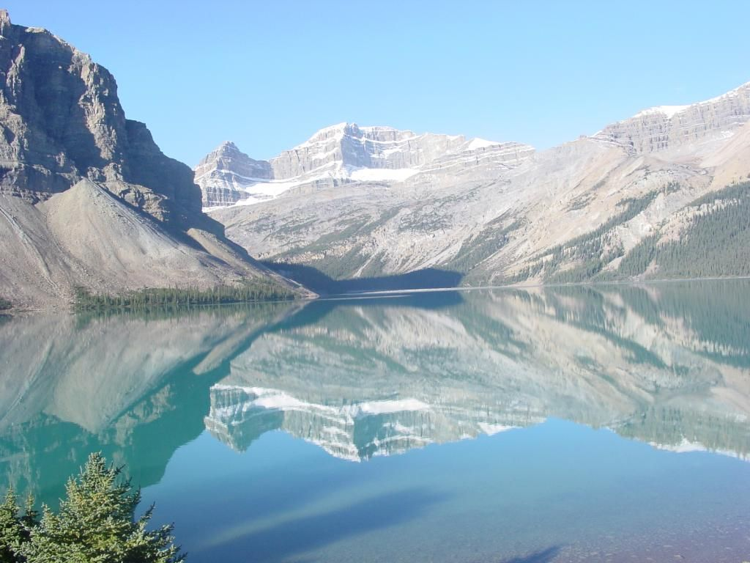
Romans 1:20
For since the creation of the world His invisible attributes are clearly seen, being understood by the things that are made, even His eternal power and Godhead, so that they are without excuse,
Psalms 19:1-3
The heavens declare the glory of God; and the firmament shows His handiwork. Day unto day utters speech, and night unto night reveals knowledge. There is no speech nor language where their voice is not heard.
Psalms 145:6
Men shall speak of the might of Your awesome acts, and I will declare Your greatness.
Palms 8:1
O LORD, our Lord, how excellent is Your name in all the earth, who set Your glory above the heavens!
Psalms 8:9
O LORD, our Lord, how excellent is Your name in all the earth!
Exodus 20:7
You shall not take the name of the LORD your God in vain, for the LORD will not hold him guiltless who takes His name in vain.
Psalms 138:2
I will worship toward Your holy temple, and praise Your name for Your lovingkindness and Your truth; for You have magnified Your word above all Your name.

Slide 6
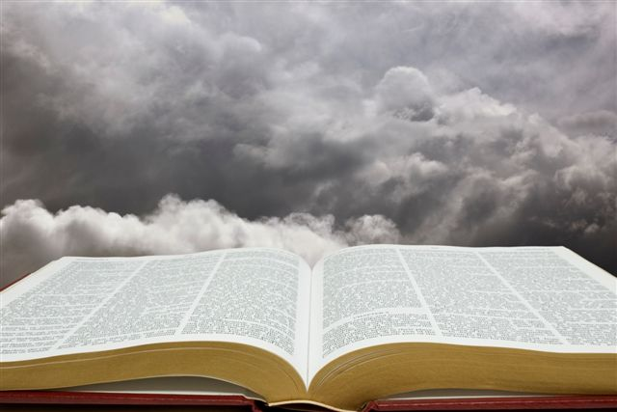
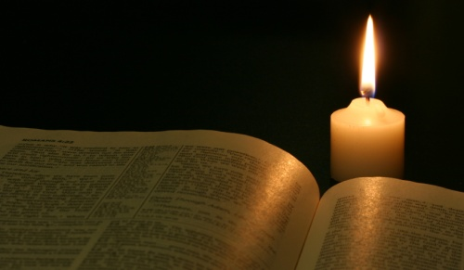
Josiah
2 Ki 22:11,13
2 Ki 23:2-3, 21, 25
Ezra &
The People
Neh 8:5-6
Cornelius
Acts 10:2
Acts 10:33
Psalms 138:2
I will worship toward Your holy temple, and praise Your name for Your lovingkindness and Your truth; for You have magnified Your word above all Your name.

Slide 7
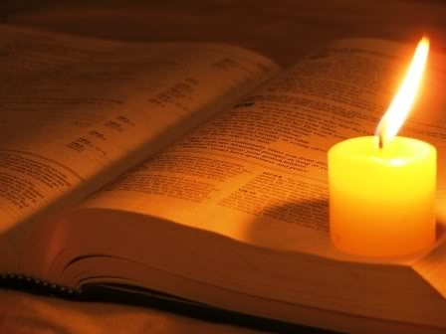
“Thus saith the Lord”
“Says the Lord”
246 Times in Bible
Hebrews 8:8
Because finding fault with them, He says: behold, the days are coming, says the Lord, when I will make a new covenant with the house of Israel and with the house of Judah--
Revelation 1:8
I am the Alpha and the Omega, the Beginning and the End, says the Lord, who is and who was and who is to come, the Almighty.

Slide 8
1 Tim 4:7
But reject profane and old wives' fables, and exercise yourself toward godliness.
Be an example in Word (12)
Give attention to reading . . . Doctrine (13)
Meditate on these things (15)
Give yourself entirely to them (15)
Take heed to yourself & your doctrine (16)
eusebeia
1) reverence, respect
2) piety towards God,

Slide 9
1 Tim 4:7
But reject profane and old wives' fables, and exercise yourself toward godliness.
bebelos
A crossing the doorway,
Walking upon the hallowed
“A threshold walker”
muthos
A narrative, story (a true narrative) (fiction, a fable) an invention.

Slide 10


Modernize their “Understanding”
Ashamed of its Inflexibilness
Projects an Easy Familiarity
Reject / Redesign / Redefine
Makes use of “Plastic Words”

Slide 11
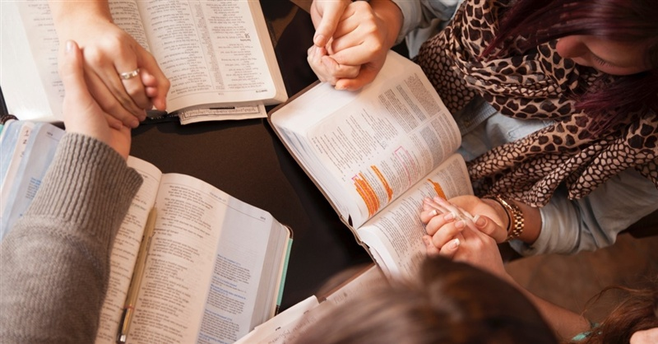
2 Peter 1:19
And so we have the prophetic word confirmed, which you do well to heed as a light that shines in a dark place, until the day dawns and the morning star rises in your hearts . . .
Deuteronomy 12:32
Whatever I command you, be careful to observe it; you shall not add to it nor take away from it.
Reverence Assures It!

Slide 12
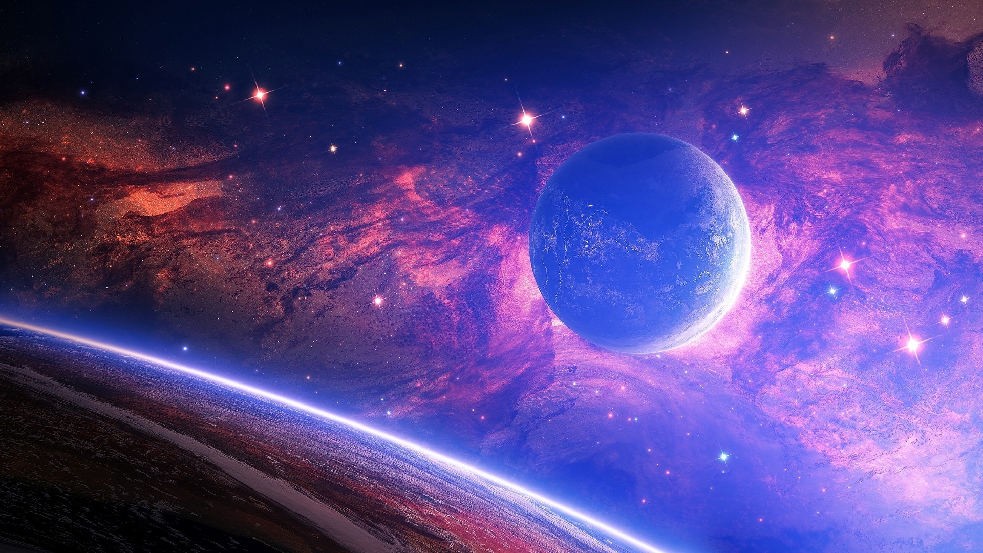
R
E
V
E
R
E
N
C
E
The Majesty of God
You Cannot Fake It
Substance of Worship
Guides My Reading
Disciplines My Life

