Slide 2

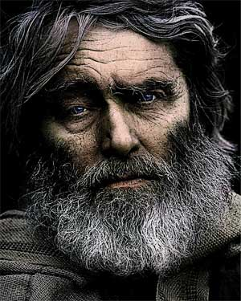
(God) delivered righteous Lot, who was oppressed by the filthy conduct of the wicked . . . (2 Peter 2:7).
“Upright, virtuous, keeping the commands of God; approved, accepted by God”

Slide 3
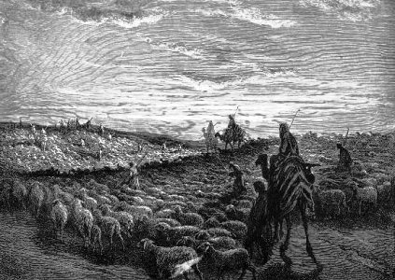
Now the land was not able to support them, that they might dwell together, for their possessions were so great . . . and there was strife . . . So Abram said to Lot, please let there be no strife between you and me . . . for we are brethren. Is not the whole land before you? Please separate from me. If you take the left, then I will go to the right; or, if you go to the right, then I will go to the left. (Genesis 13:6-9)
This is the genealogy of Terah: Terah begot Abram, Nahor, and Haran. Haran begot Lot . . . And Terah took his son Abram and his grandson Lot, the son of Haran, and his daughter-in-law Sarai, his son Abram’s wife, and they went out with them from Ur of the Chaldeans to go to the land of Canaan; and they came to Haran and dwelt there. (Gen 11:27, 31)
Then Abram took Sarai his wife and Lot his brother’s son, and all their possessions that they had gathered, and the people whom they had acquired in Haran, and they departed to go to the land of Canaan. So they came to the land of Canaan. (Genesis 12:5)
Then Abram went up from Egypt, he and his wife and all that he had, and Lot with him, to the South. Abram was very rich in livestock, in silver, and in gold. (Genesis 13:1-2)

Slide 4
Lot Lifted His Eyes and Saw (Gen 13:10)
Lot Chose For Himself (Gen 13:11)
Lot pitched His Tent as far as Sodom (Gen 13:12)

Slide 5
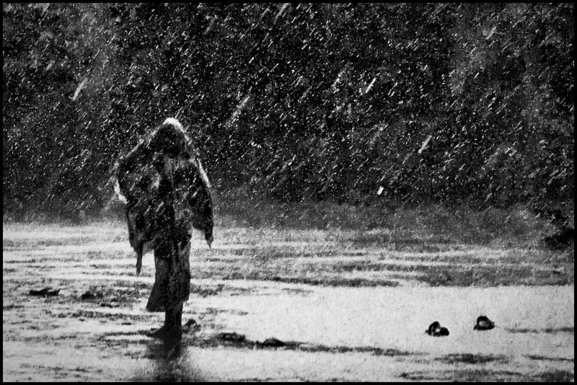
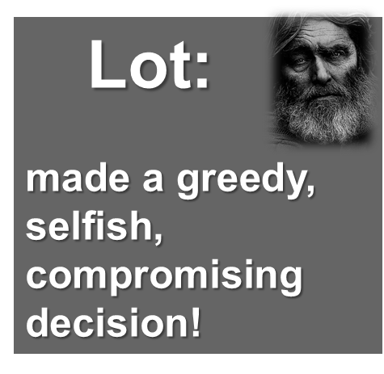
Lot, How Did it Work Out for You?
How did it help you Spiritually?
How did it help your Family?
How did it help Sodom?
How much Money did you make?

Slide 6
