Slide 1

SCRIPTURE READING
ACTS 3:1-10

Slide 2
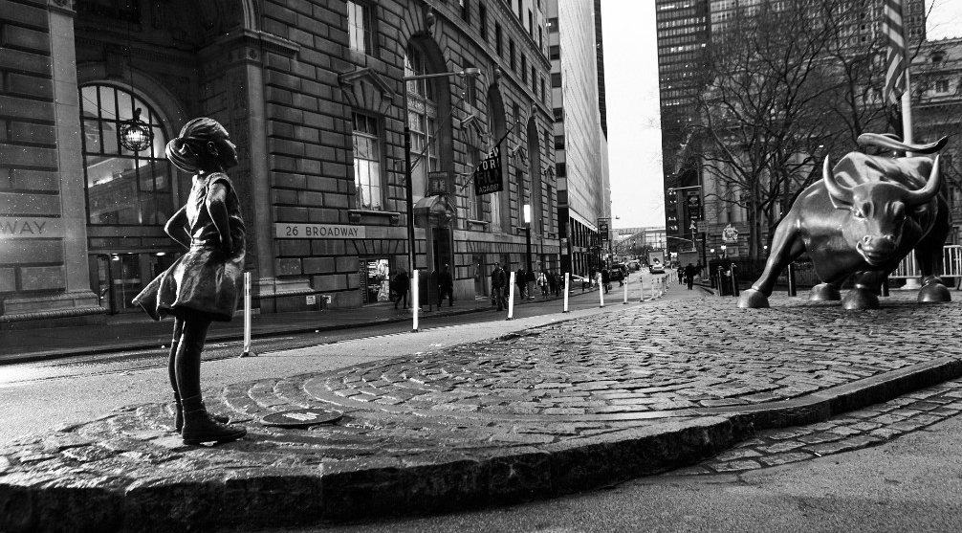
STANDING BEFORE THE COUNCIL:
WHOM SHALL WE HEED?
ACTS 4:1-22

Slide 3
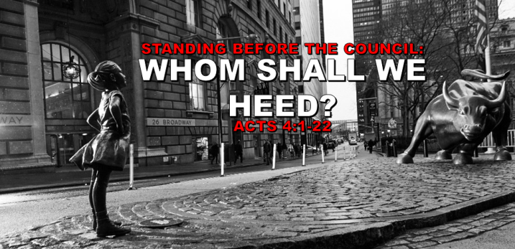
THE PRIESTS
  THE SANHEDRIN
    AUTHORITY TO SENTENCE
THE CAPTAIN OF THE TEMPLE GUARD
  AUTHORITY TO ARREST
WHO ARRESTED THE APOSTLES?

Slide 4
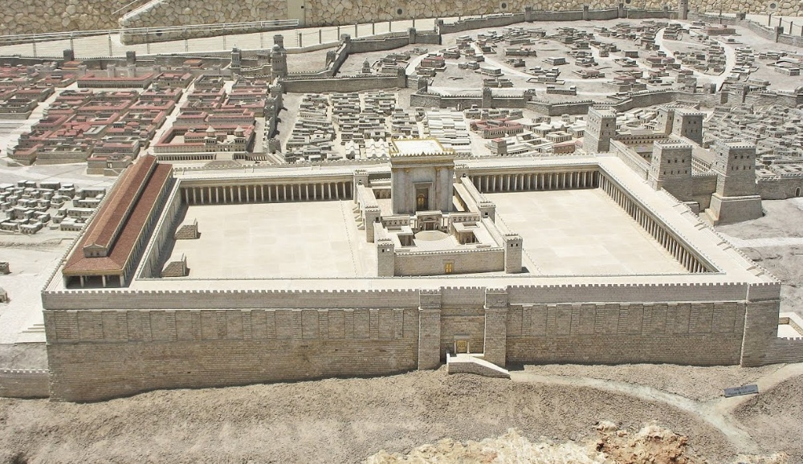
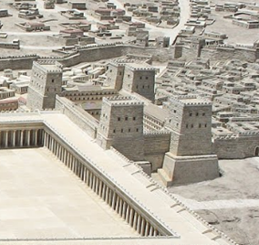
FORTRESS OF ANTONIA

Slide 5
THE PRIESTS
  THE SANHEDRIN
  AUTHORITY TO SENTENCE
THE CAPTAIN OF THE TEMPLE GUARD
  AUTHORITY TO ARREST
THE SADDUCEES
  OPPOSED TO THE APOSTLES TEACHING ON RESURRECTION
WHO ARRESTED THE APOSTLES?

Slide 6
THERE WAS NO RIOT OR TUMULTUOUS DISTURBANCE
NOT FOR MISBEHAVIOR ON THE APOSTLE’S PART
WHY WERE THE APOSTLES ARRESTED?

Slide 7
PLEASE TURN IN YOUR BIBLES
TITUS 3:1-11
AND
2 TIMOTHY 2:22-26

Slide 8
THERE WAS NO RIOT OR TUMULTUOUS DISTURBANCE
NOT FOR MISBEHAVIOR ON THE APOSTLE’S PART
IT WAS THE JEWISH REACTION TO THE PREACHING OF THE TRUTH
WHY WERE THE APOSTLES ARRESTED?

Slide 9
“Honor all people, love the brotherhood, fear God, honor the king…For this finds favor, if for the sake of conscience toward God a person bears up under sorrows when suffering unjustly. For what credit is there if, when you sin and are harshly treated, you endure it with patience? But if when you do what is right and suffer for it you patiently endure it, this finds favor with God. For you have been called for this purpose, since Christ also suffered for you, leaving you an example for you to follow in His steps…” 1 Peter 2:17-21 (NASB)

Slide 10
ANNAS
  FATHER-IN-LAW OF CAIAPHAS
  FORMER HIGH PRIEST
CAIAPHAS
  CURRENT HIGH PRIEST
  DECLARED JESUS SHOULD DIE (JOHN 18:12-14)
THE ACCUSATIONS & APOSTLE’S RESPONSE

Slide 11
CONSIDER THEIR ATTITUDE
  NO HOSTILITY OR HATE
CONSIDER THEIR ACTION
  THEY PREACHED SALVATION
THE ACCUSATIONS & APOSTLE’S RESPONSE

Slide 12
“AND THERE IS SALVATION IN NO ONE ELSE; FOR THERE IS NO OTHER NAME UNDER HEAVEN THAT HAS BEEN GIVEN AMONG MEN BY WHICH WE MUST BE SAVED.”

Slide 13
“WHETHER IT IS RIGHT IN THE SIGHT OF GOD TO GIVE HEED TO YOU RATHER THAN TO GOD, YOU BE THE JUDGE; FOR WE CANNOT STOP SPEAKING ABOUT WHAT WE HAVE SEEN AND HEARD.”

Slide 14
STANDING BEFORE THE COUNCIL:
WHOM SHALL WE HEED?
ACTS 4:1-22

