Slide 1
2019 Theme
Lights in a Dark World
Philippians 2:15

Slide 2
Is Your Light
Shining In Your Neighborhood?

Slide 3
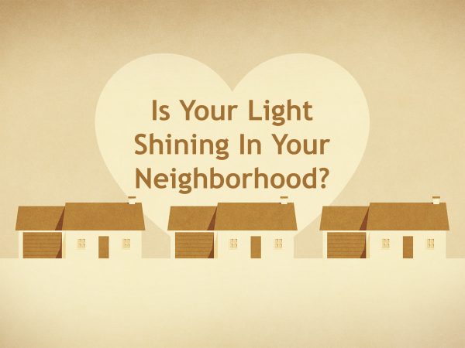
One of our goals is to win others to the Lord
Matthew 5:13-16
Cf. 1 Corinthians 14:25
Evangelism and our Neighbors

Slide 4
Our best prospects are those close to us. Does this include our neighbors?
Studies show this to be the most effective way to reach other
Evangelism and our Neighbors

Slide 5
But how do we develop opportunities?
Cf. 1 Peter 3:1-2 – while addressing wives, it mentions examples
Our example is our best tool to begin with
Evangelism and our Neighbors

Slide 6
Who is my neighbor?
Luke 10:27-29
Interacting with a lawyer, Jesus tells the account of the Good Samaritan (10:30-37)
You neighbor is anyone who crosses your path, whom you have opportunity to do good for – physically and spiritually

Slide 7
Who is my neighbor?
Luke 10:27-29
Love your neighbor as yourself
A statement found in Leviticus 19:18, and several times in the NT – Matthew 22:39, Romans 13:9, Galatians 5:14, James 2:8

Slide 8
Who is my neighbor?
Luke 10:27-29
Love your neighbor as yourself
This is fundamental in dealing with others
To what degree? Even as yourself –
cf. Ephesians 5:28-29

Slide 9
We ought to love them! This will affect everything else
Proper decorum – well kept, cleanliness. An asset to the neighborhood
(cf. Proverbs 24:30-34)
Romans 13:13 – properly – characterized by proper manners and conduct.
1 Thessalonians 4:12
Qualities of being a good neighbor

Slide 10
Be respectful
Be the neighbor that none regret being around
Romans 12:17-18 – live peaceably with all men
1 Corinthians 9:19-23 – all things to all men
Qualities of being a good neighbor

Slide 11
Be respectful
Watch your attitude – have regard…
Romans 12:19 – do not avenge yourselves
Colossians 3:12 – put on tender mercies…
1 Corinthians 13:4-6 – describes love
Qualities of being a good neighbor

Slide 12
Be respectful
Speak truthful – have regard…
Ephesians 4:25 – Be honest and dependable. Keeping your word (cf. Matthew 5:37)
Watch your language –
Proverbs 11:9, 12
Qualities of being a good neighbor

Slide 13
Be respectful
Do not engage in ungodliness
Ephesians 4:25-32 – control anger, don’t steal, no bitterness, wrath, etc.
Psalm 15:3 – He does no evil to his neighbor
Proverbs 3:29, Romans 13:10
Qualities of being a good neighbor

Slide 14
Be respectful
Romans 15:2, let each one please his neighbor for his good, leading to edification
1 Peter 2:12 – Is your conduct “honorable among the Gentiles”?
Qualities of being a good neighbor

Slide 15
Be benevolent
Galatians 6:10, 1 John 3:17-18, Hebrews 13:2, James 1:27 Consider Jesus and His compassion
Consider Dorcas – Acts 9:36-42, Cornelius - 10:1-2, etc.
God notices when we are caring
Don’t let this be the only reason you help. Be genuine
Qualities of being a good neighbor

Slide 16
Pray for them
1 Timothy 2:1-2 – pray for all men
Proverbs 25:17 – Seldom set foot in your neighbor’s house, lest he become weary of you and hate you
Qualities of being a good neighbor

Slide 17
People are watching!
Is your light shining in your neighborhood?

