Slide 1
Lessons from a Widow
1 Kings 17

Slide 2
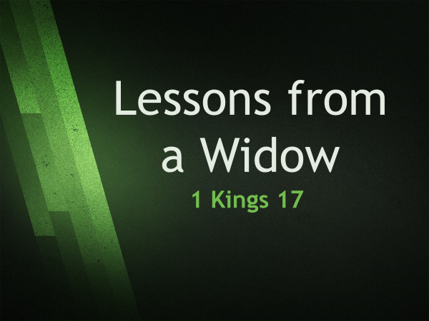
Background & Story
Ahab is king of Israel – a very wicked king (1 Kings 16:33) – Baal worshipped, married Jezebel
We are also introduced to Elijah (1 Kings 17:1) – one of God’s more prominent prophets (recorded). He was rejected (1 Kings 18:17).
Mentioned some 30 times in NT – did not see death and met with Jesus (Matthew 17:3ff)

Slide 3
Background & Story
1 Kings 17:1, he enters the scene proclaiming a drought (3½ years – James 5:17). Then he flees into the wilderness and is sustained by the LORD Then he is sent to Zarephath (Sidon) where he is told a widow would provide for him (17:8-9)

Slide 4
Background & Story
1 Kings 17:8-16, we read of this widow woman and her encounter with Elijah. She has nothing but listens to Elijah’s instructions to feed him – as a result her flour and oil never ran out until the drought ended.

Slide 5
Background & Story
1 Kings 17:17-24, the account continues with her son becoming ill and dying. She blames Elijah and the LORD. But Elijah prays and the boy is revived (1st resurrection recorded)
1 Kings 17:24, Now…I know you are a man of God, and His word is truth

Slide 6
Lessons to consider
Concerning God:
He is in control – 1 John 4:4, Romans 8:28, Matthew 19:26, Proverbs 19:21
God can still work even in the ungodliest of times - Sometimes His greatest work. He can do whatever needs to be done! Consider God’s plans

Slide 7
Lessons to consider
Concerning God:
He can take care of you – sometimes in unusual ways. He sustained both Elijah and the widow woman 1 Peter 5:7, Philippians 4:19 cf. Matthew 6:25-34

Slide 8
Lessons to consider
Concerning God:
God keeps His word – again, He took care of Elijah and the widow woman as promised . Throughout scripture we find this to be so Numbers 23:19 1 Thessalonians 5:24 Hebrews 10:23

Slide 9
Lessons to consider
Concerning God:
He can use unlikely people to accomplish His will – Elijah is sent to the region where Baal worship was prevalent. He can and will use whoever He chooses. We sometimes turn to Him for help – How he answers we do not know, but at times it is not as we thought. But it happens!

Slide 10
Lessons to consider
Concerning the widow:
A godly woman is useful – God needs everyone. That is why we must not show partiality (James 2:1, Acts 10:34-35) We ALL have something we can (and cannot) do – God needs us – Galatians 3:26-28

Slide 11
Lessons to consider
Concerning the widow:
Our need for faith – perhaps the most direct lesson of this account.
What is faith? Trusting God and believing Him (Hebrews 11:1), not mere belief IN Him This widow had extraordinary faith – why did she trust Elijah and the LORD? (In hostile territory)

Slide 12
Lessons to consider
Concerning the widow:
Our need for faith – Hers was an active (obedient) faith – the ONLY type that God will accept (James 2:17)
We have a Gentile who trusted God – God cares about EVERYONE! So should we. Consider Luke 4:24-27 where Jesus mentions this event

Slide 13
Lessons to consider
Concerning us:
Sometimes your acts of kindness for another helps them – Just a small piece of bread and water was enough. God took note – Matthew 10:42 Hebrews 13:2 We are to be kind and loving to all – even if we think no one else is watching. God is! Philippians 2:15 – let it shine

Slide 14
Lessons to consider
Concerning us:
Don’t assume a little help to someone or FROM someone is trivial – Luke 21:2-4, Jesus knew what those two mites meant! Be grateful when someone does something little for you – you never know what it will mean. - Consider our times – are we kind to the clerk at grocery store, or at the takeout counter? Do we say thank you?

Slide 15
Lessons to consider
Concerning us:
Don’t assume a little help to someone or FROM someone is trivial – Luke 21:2-4, Jesus knew what those two mites meant! Be grateful when someone does something little for you – you never know what it will mean. - Consider our times – are we kind to the clerk at grocery store, or at the takeout counter? Do we say thank you? Be different!

Slide 16
Lessons to consider
Concerning us:
Finally, our faith is one of our best evangelistic tools – we need to be people of faith and live it! People notice if you live with doubts or are inconsistent. If you show trust in God in words, attitudes and deed – it will be noticed. 1 Kings 17:24

Slide 17
Do you turn to God and His word for strength?

Slide 18
Let us pray!

